Slide 1
Classify!
Create a classification key
Notes:
Teacher notes can be found here throughout the presentation.

Slide 2
Classification
All plants and animals can be divided into groups by looking at similarities and differences
BIG CATS
yourgenome.org
Notes:
All plants and animals can be divided into groups by looking at similarities and differences.
For example all of these animals would be grouped together as big cats based on their similar features – what are they?

Slide 3
Animal groups
Animals can be split broadly into two groups:
Animals with backbone
Animals without backbone
VERTEBRATES
INVERTEBRATES
yourgenome.org
Notes:
Animals can be split broadly into two groups: vertebrates (animals with backbones) and invertebrates (animals without backbones)
Can you name any vertebrates?
Can you name any invertebrates?

Slide 4
How do scientists classify creatures?
Scientists organise living things into groups based on :
What they look like
How similar their DNA is
Mnolf, Wikimedia commons
E Yakhanotov, Wikimedia commons
Common Pipistrelle
(Pipistrellus pipistrellus)
Soprano Pipistrelle
(Pipistrellus pygmaeus)
yourgenome.org
Notes:
Classification on observations alone is possible but DNA provides great evidence to support an identification, especially if it a species that looks very similar to another.
Ask students if they know / remember what DNA is? All living things have DNA, its like a instruction book. Every species DNA is different so comparing DNA can show if an animal is one species or another.
Use the Pipistrelle bat as an example to show how both observations AND DNA can identify new species.
In 1999 it was discovered there were actually two species – Common pipistrelle (Pipistrellus pipistrellus) and the Soprano pipistrelle (Pipistrellus pygmaeus). The two species were first distinguished on the basis of their different-frequency echolocation calls. The common pipistrelle uses a call of 45 kHz, while the soprano pipistrelle echolocates at 55 kHz. DNA tests also confirmed they were two separate species.

Slide 5
Which is the closest living relative?
Most closely related to…
Marmot
Rock Hyrax
Elephant
yourgenome.org
Notes:
The Hyrax is another interesting case. Which of these animals do you think is the closest living relative? The furry marmot or the big African elephant?
The answer is – the elephant. Weird right?
Well Hyraxes, elephants and dugongs (sea cows) all evolved from a single common ancestor millions of years ago. The Hyrax has several features that it shares with the elephant such as they have tusks – all be it little ones, flattened nails on the tips of their toes, and similar skull structure.
Comparing the DNA of these two animals also shows that they are closely related.

Slide 6
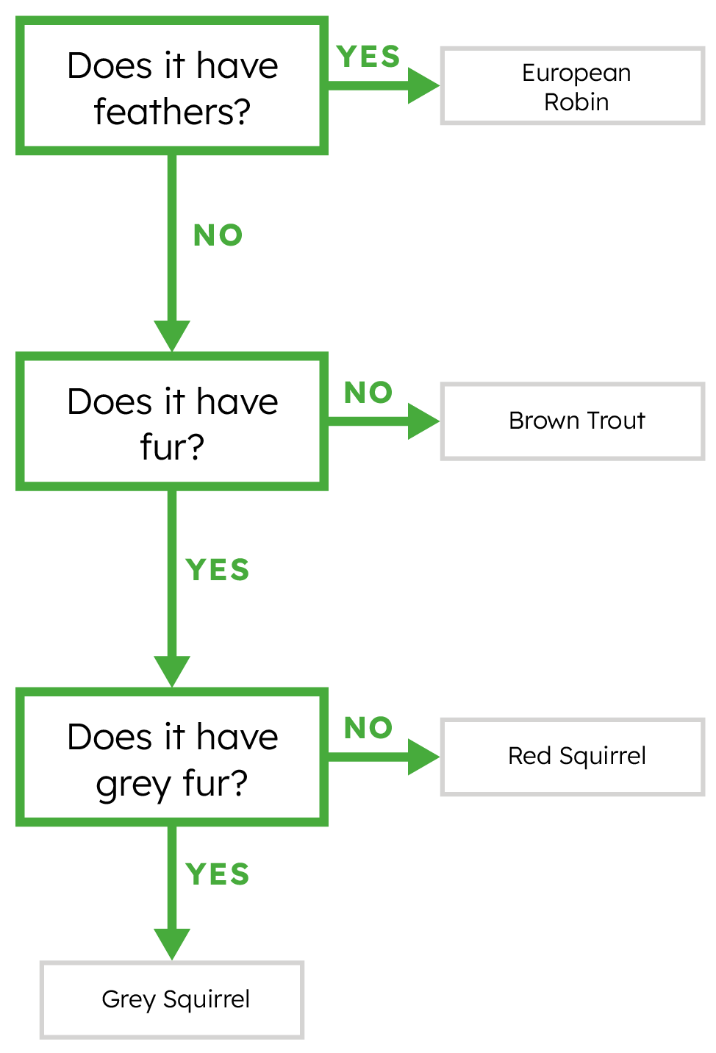
Using classification keys
Asking a few questions about an animal can help you classify it.
European Robin
Red Squirrel
Brown Squirrel
Brown Trout
yourgenome.org
Notes:
Using classification keys can be very simple!
Classification keys allow you to ask a series of questions about an organism to help you identify which species you are looking at.
Always start with the first question – in this example, the first question is does it have feathers? The answer to each question should always be yes or no. This kind of key is called a dichotomous classification key. Dichotomous means divided in to two parts (e.g. yes or no).
So, how do we use the key? Look at the top picture on the left hand side and ask yourself the first question. Does it have feathers? The answer in this case is yes, so the species we are looking at must be the robin.
Let’s look at the picture below? Does it have feathers? No. This means we must ask ourselves the second question: Does it have fur? This species does have fur so follow to the next question. Does it have grey fur? Yes – so it is a grey squirrel.
Repeat for the top right picture – it is very similar so follow the same pathway but it does not have grey fur so must be the red squirrel.
The final picture – it does not have feathers or fur so it is a trout.
In this activity you will have the chance to make your own classification key to identify some of the species being sequenced.

Slide 7
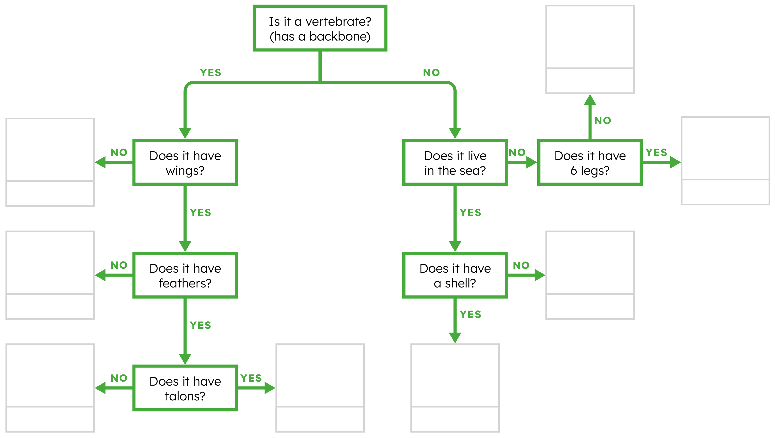
Let’s Classify!
yourgenome.org
Notes:
Talk through how to use the classification key to sort the creatures!

Slide 8
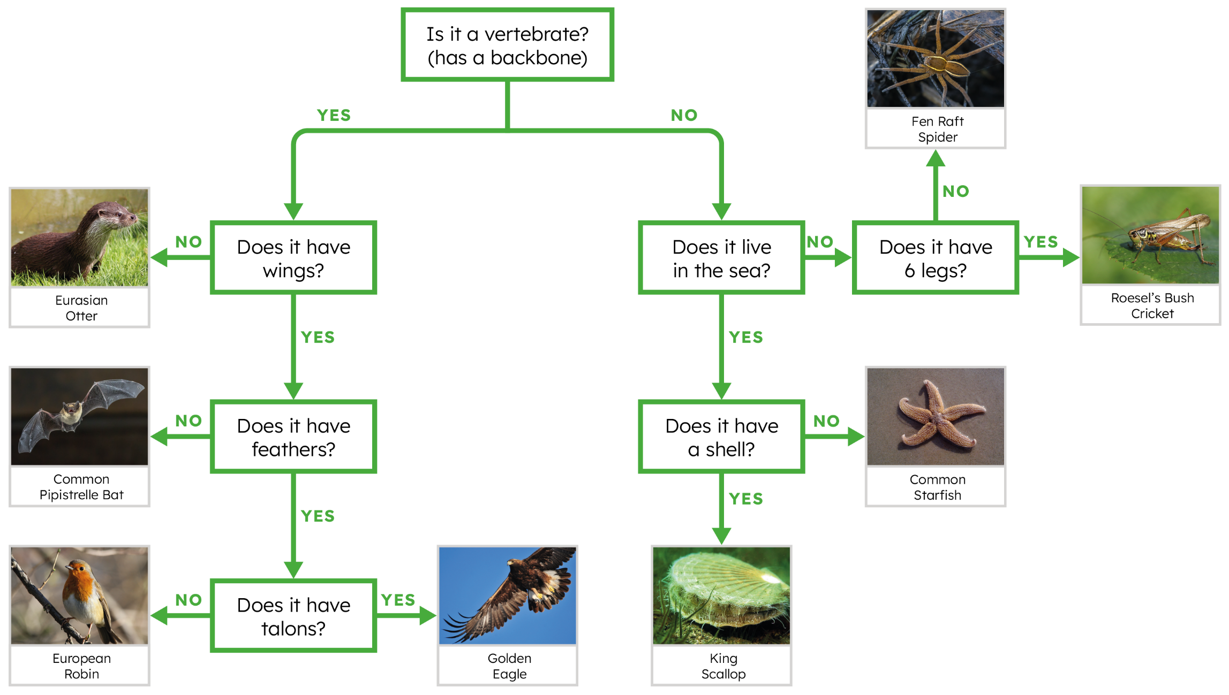
Answers
yourgenome.org
Notes:
Talk through the answers.

