Slide 1
Wild DNA
Investigate eDNA

Slide 2
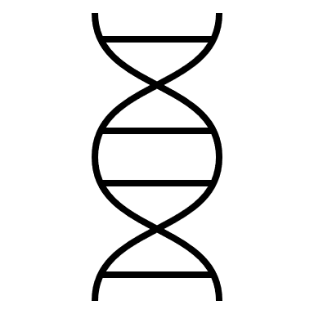
DNA function
DNA is the long molecule that contains the instructions for an organism
These instructions give the information needed for an organism to develop, grow and function
Different organisms have different instructions in their DNA
The instructions for an organism are found in their DNA sequence
yourgenome.org

Slide 3
DNA sequence
DNA sequences are a series of letters (A, C, G and T), which represent bases in the DNA
ATTCGCGTATTAGCGCGATAGCTCTGCGCTATATAGCGGCGATATATATGATGTGAGTCGTGCTGATGCGTGAGTCGTAGTGCTGCGATGCTGTCGATTAGTCGCTGTCGATGATGAGAGACGATAGCAGATACTACGACATCAGCATCAGACATC
The DNA sequence is unique to an organism, so we can use it to identify which organism a DNA sample comes from
ATTCGCGTATTAGCGCGATAGCTCTGCGCTATATAGCGGCGATATATATGATGTGAGTCGTGCTGATGCGTG
ATTCGGCTATTAGCGCGATAGCTCTCCGCTATATAGCGGCGATATATATGATGTGAGTCGTGCTGATGTTTG
yourgenome.org

Slide 4
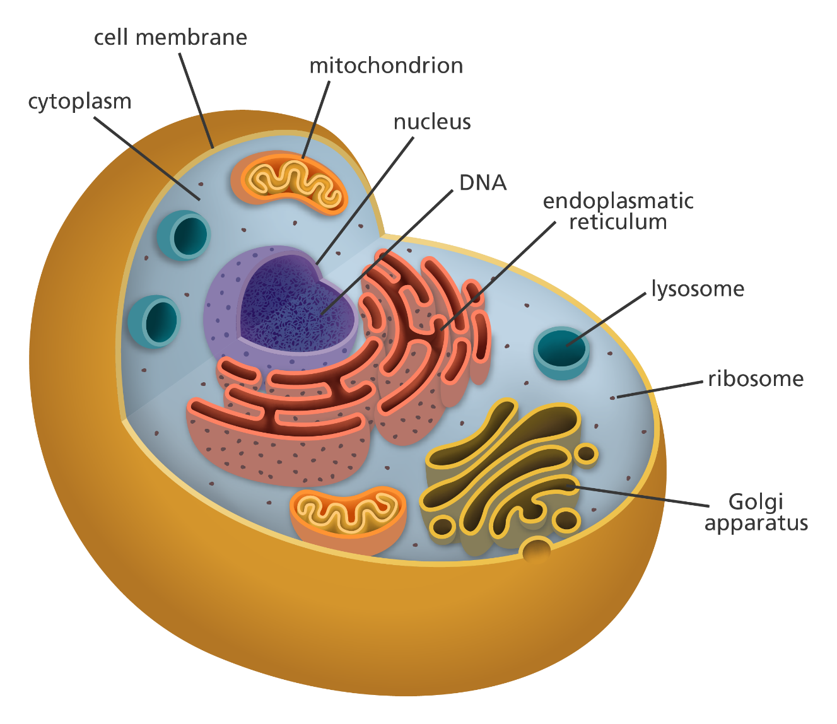
DNA location
DNA is found in the nucleus of cells from eukaryotic species
When cells are replaced, old cells can be left behind in the environment
This means the DNA in these cells will also be left behind in the environment
Animal cell
yourgenome.org
Image credit: Laura Olivares Boldú / Wellcome Connecting Science

Slide 5
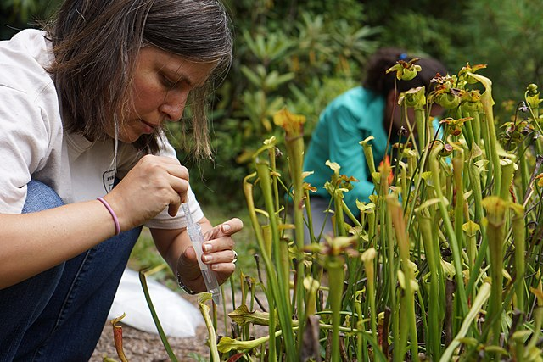
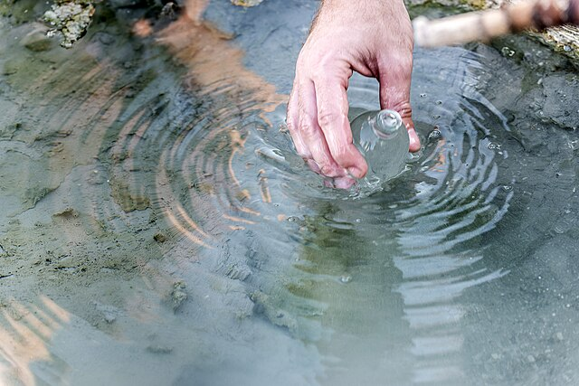
What is eDNA?
eDNA stands for: environmental DNA
It is DNA left by an organism in an environment
eDNA could be found in old cells left behind in:
faeces
external cells shed by an organism (e.g. skin cells)
bodily fluids (e.g. blood or urine)
eDNA can be collected from the environment
Image credit: Albert Herring
Image credit: André Künzelmann
Image credit: Adam Rash
yourgenome.org

Slide 6
What can eDNA be used for?
Current research is using eDNA to:
detect species in an area
determine approximate population density in an area
study the impact of climate change
monitor for diseases
assess overall health of an ecosystem
For example, eDNA can be used to estimate population density of commonly fished species, using water samples from fishing locations.
This can indicate if an area is at risk of over-fishing.
Image credit: Joachim Mullerchen
yourgenome.org

Slide 7
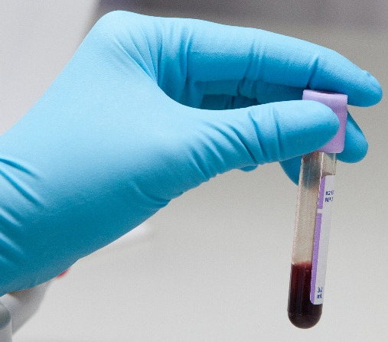
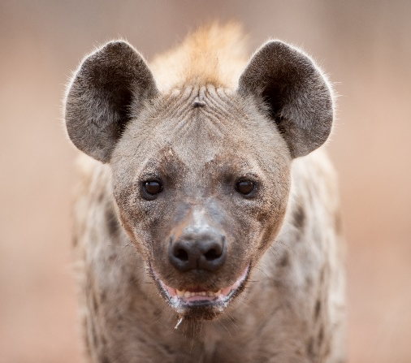
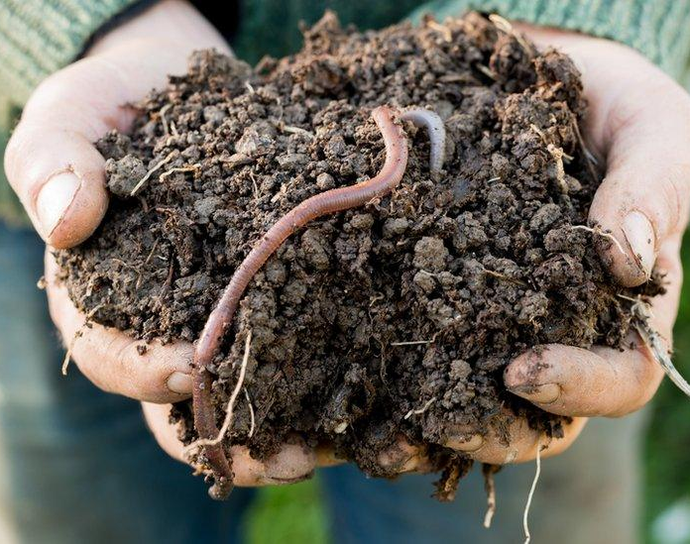
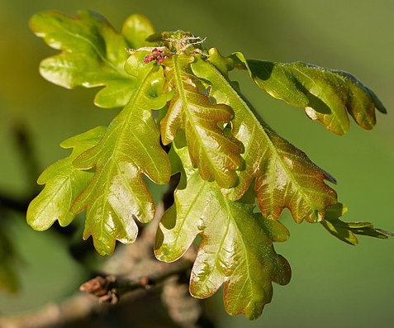
DNA sampling
eDNA can be obtained from:
blood
excrement
saliva
soil
leaves
water samples
Image credit: phloxii
Image credit: Freepik
Image credit: PhotographyFirm
Image credit: W.carter
Image credit: André Künzelmann
yourgenome.org

Slide 8
How does eDNA sampling work?
Collect sample
Extract DNA in a lab
Sequence DNA
Analyse data
Samples are collected from different locations in a wetland area and sent to the lab
eDNA is extracted, processed and sent for DNA sequencing
Bioinformatics is used to compare the DNA found to an online DNA database, allowing identification of the species present in the area
yourgenome.org

Slide 9
The benefits of identifying species
All species in an ecosystem will have an impact through:
their habitat
competition for resources
position in the food web
By identifying species using eDNA, not only do we know about the organisms found in an ecosystem, but we can consider their impact and the effect of changes on them.
yourgenome.org

Slide 10
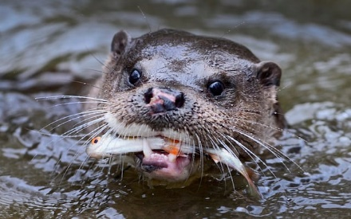
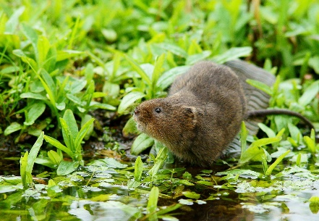
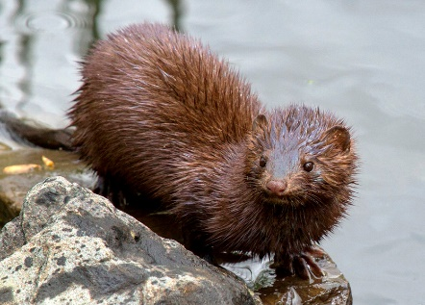
The benefits of identifying species
For example:
Predator populations, if unchecked, can drastically reduce populations of prey.
Image credit: Education images / Universal Images Group Editorial
Endangered species in an ecosystem may require additional measures for protection, such as maintaining water quality in their habitat.
Image credit: Peter Trimming
Invasive species introduced into an area will not have evolved with predators and may bring new diseases – factors which can lead to them outcompeting similar native species in the ecosystem.
Image credit: Chuck Homler
yourgenome.org

Slide 11
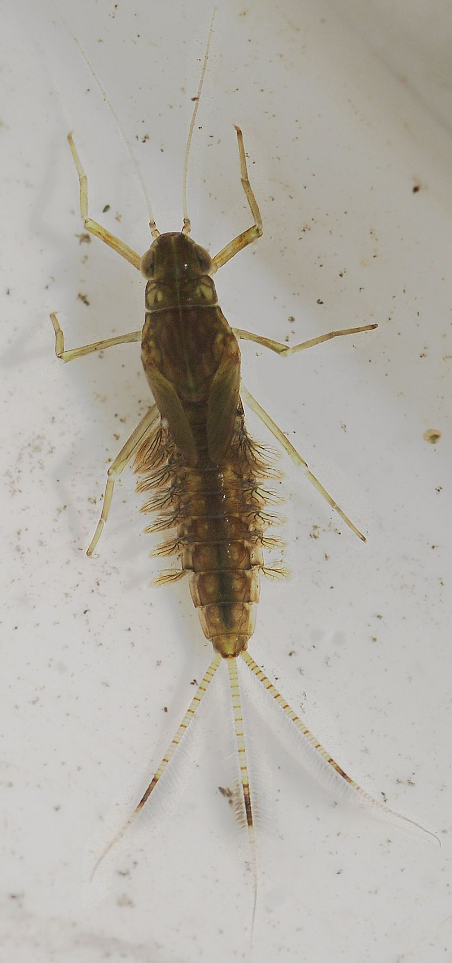
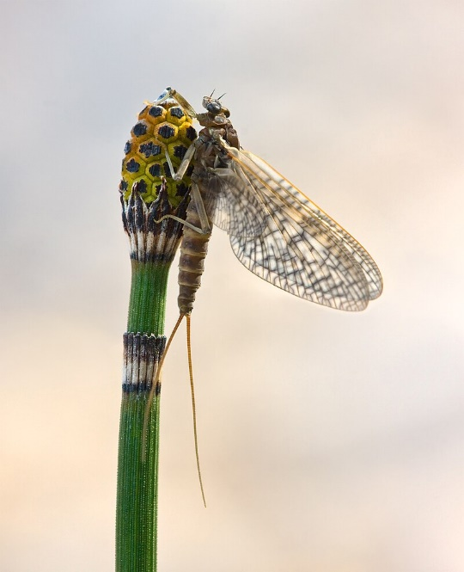
The benefits of identifying species
For example:
Some species act as indicators for the health of an ecosystem, like water quality, and humans can actively maintain the environment to support their populations.
Image credit: Thom Quine
Image credit: Ian Alexander
Image credit: Richard Bartz
yourgenome.org

Slide 12
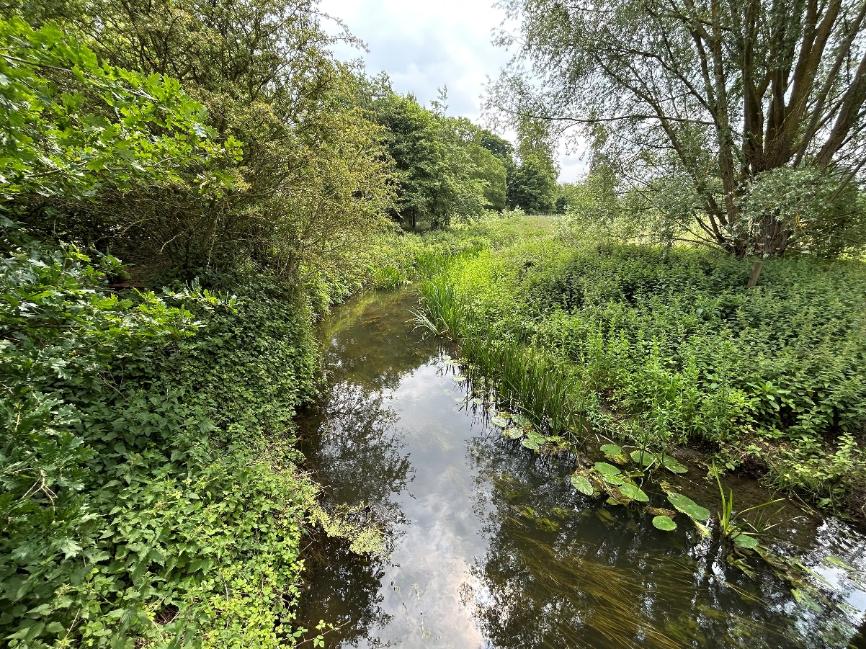
Wild DNA challenge
Your company has been asked to carry out an ecological survey of a wetlands area and river system.
Working in groups, you need to:
Identify the species living in your location using bioinformatics to compare eDNA sequences to an online DNA database
Consider the impact of these organisms on the ecosystem
Image credit: Wellcome Connecting Science
yourgenome.org

Slide 13
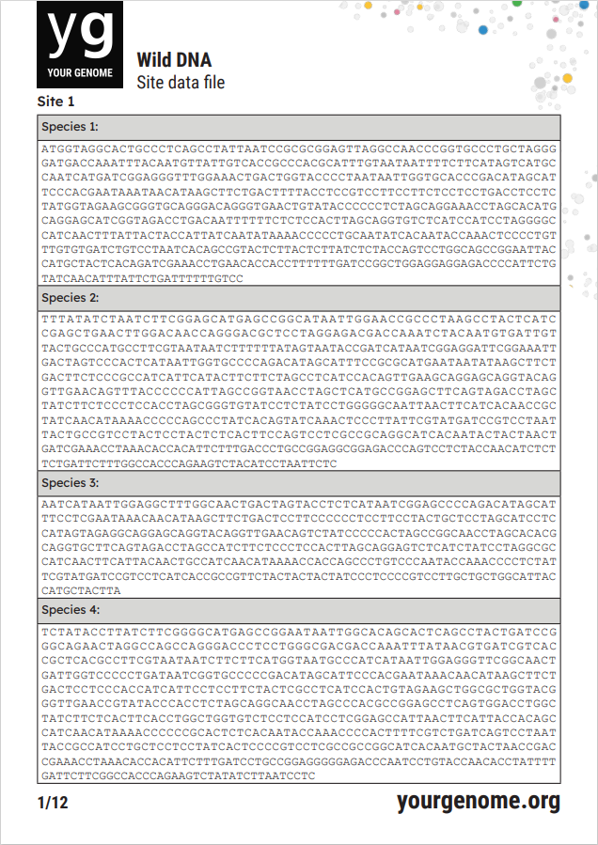
Wild DNA challenge
Step 1:
Open the ‘Site data file’ document for your location on your computer.
yourgenome.org

Slide 14
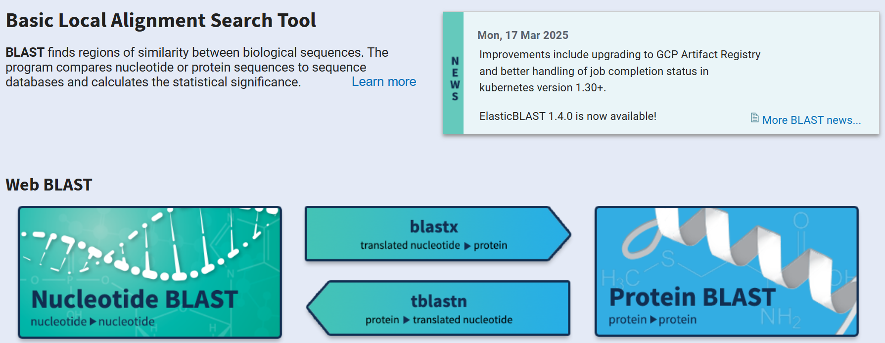
Wild DNA challenge
Step 2:
Go to https://blast.ncbi.nlm.nih.gov
Step 3:
Click ‘Nucleotide BLAST’.
yourgenome.org

Slide 15
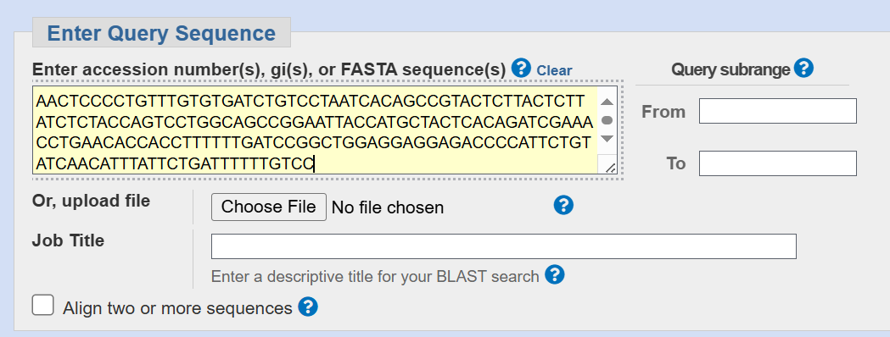
Wild DNA challenge
Step 4:
Copy your DNA sequence and paste into the ‘Enter Query Sequence Box’.
yourgenome.org

Slide 16
Wild DNA challenge
Step 5:
Click ‘BLAST’ at the bottom of the page to search the DNA database for a matching sequence.
yourgenome.org

Slide 17
Wild DNA challenge
Step 6:
On the results page, scroll down to ‘Sequences producing significant alignments’.
This will show a description of the sample your eDNA matches and the scientific name of the species.
Description of sample
Scientific name of species
yourgenome.org

Slide 18
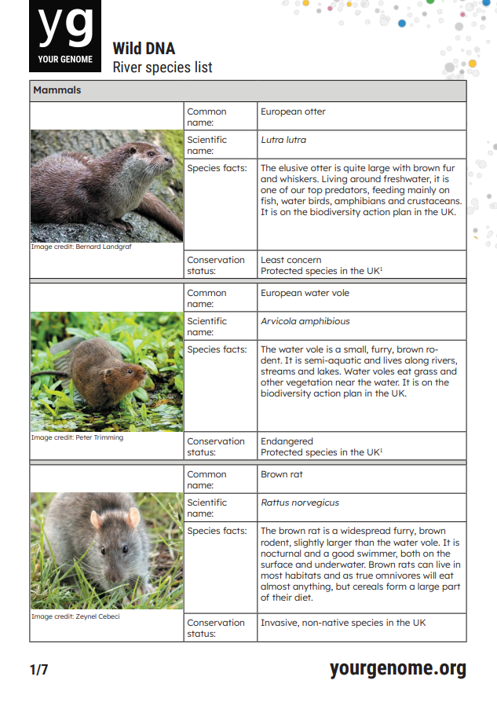
Wild DNA challenge
Step 7:
Once you have identified a species present at your site, use the ‘River species list’ document to find out:
its common name
facts about it
its conservation status
yourgenome.org

Slide 19
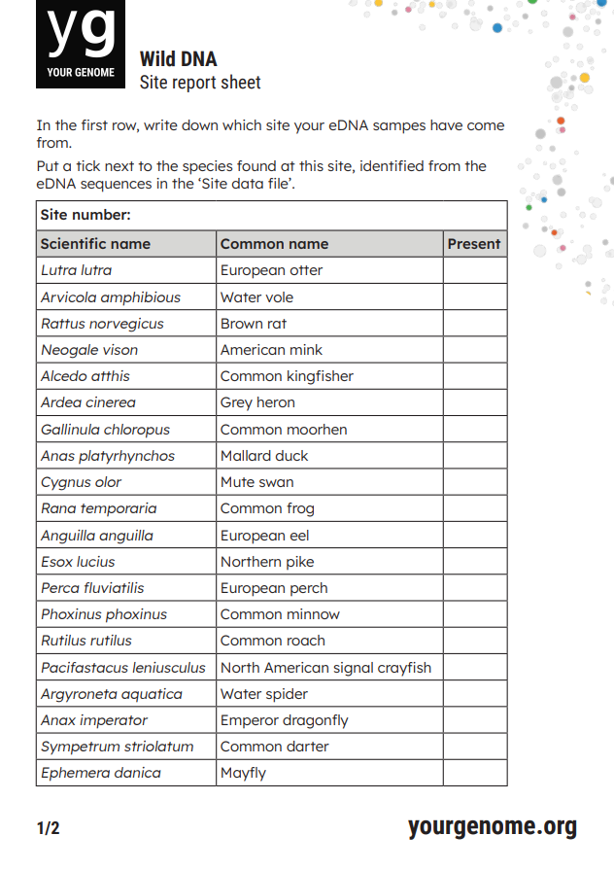
Wild DNA challenge
Step 8:
Put a tick on your ‘Site report’ sheet to record the presence of the species.
yourgenome.org

Slide 20
Wild DNA challenge
Step 9:
Repeat steps 3-8 to identify which species each DNA sequence comes from, and to complete the table on your ‘Site report’ sheet.
Step 10:
Consider the impact each species at your site may have on the ecosystem. Find out more about each species using the ‘River species list’
Which are predators?
Are there any endangered species present?
Are there any invasive species present?
Are any species indicators of good water quality?
yourgenome.org

Slide 21
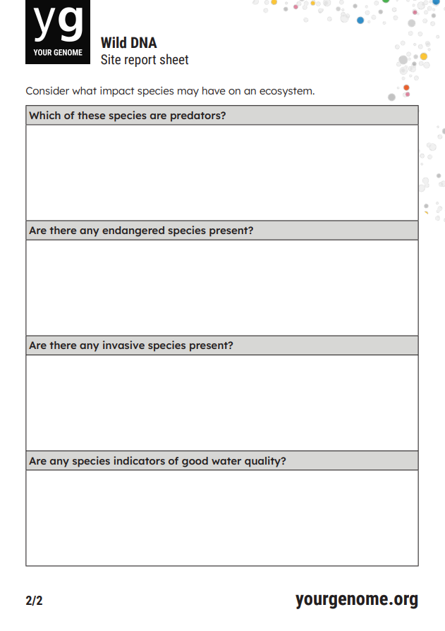
Wild DNA challenge
Step 11:
Record your findings on the second side of your ‘Site report’ sheet.
yourgenome.org

Slide 22
Wild DNA
Answers

Slide 23
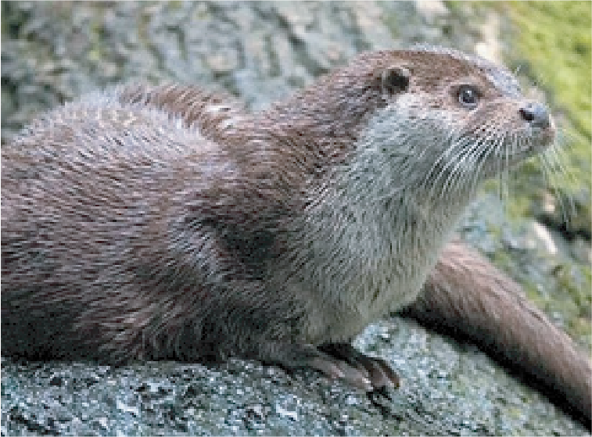
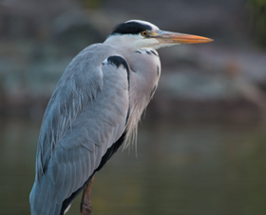
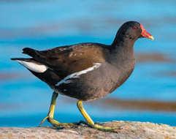
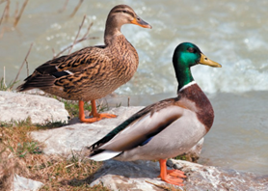
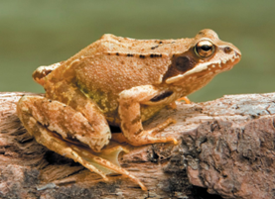
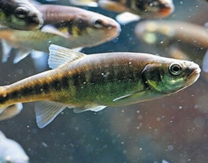
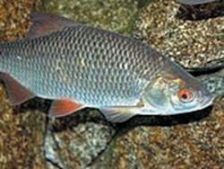
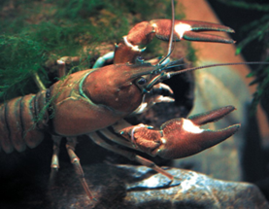
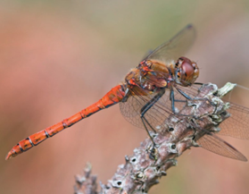
Site 1 – species in the ecosystem
European otter
Grey heron
Common moorhen
Mallard duck
Common frog
Common minnow
Common roach
North American signal crayfish
Common darter
Image credit: Bernard Landgraf
Image credit: Laitche
Image credit: Alexis Lours
Image credit: Richard Bartz
Image credit: Richard Bartz
Image credit: Clément Bardot
yourgenome.org
Image credit: Karelj
Image credit: Astacoides
Image credit: L B Tettenborn

Slide 24
Site 1 – impact on the ecosystem
Which of these species are predators?
European otter, grey heron, North American signal crayfish
Are there any endangered species present?
None at this location
Are there any invasive species?
North American signal crayfish: Burrow into riverbanks, damaging structure and vegetation. Outcompeted and infected native white-clawed crayfish with fungal disease.
Are any species indicators of good water quality?
None at this location
yourgenome.org

Slide 25
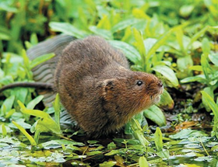
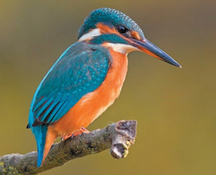
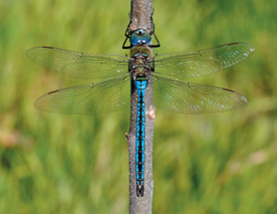
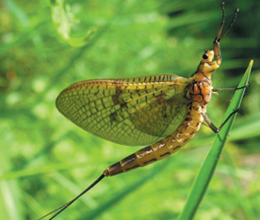
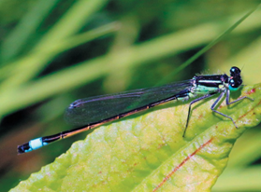
Site 2 – species in the ecosystem
European water vole
Common kingfisher
Mallard duck
Common frog
Common minnow
Common roach
Emperor dragonfly
Common mayfly
Blue tailed damselfly
Image credit: Peter Trimming
Image credit: Andreas Trepte
Image credit: Richard Bartz
Image credit: Richard Bartz
Image credit: Clément Bardot
Image credit: Karelj
yourgenome.org
Image credit: Quartl
Image credit: Zapyon
Image credit: Charles J Sharp

Slide 26
Site 2 – impact on the ecosystem
Which of these species are predators?
Common kingfisher
Are there any endangered species present?
Water vole
Are there any invasive species?
None at this location
Are any species indicators of good water quality?
Common mayfly: Sensitive to pollution, their presence is a strong indicator of good water quality as they require oxygen-rich water to lay their eggs and for nymphs to develop.
yourgenome.org

Slide 27
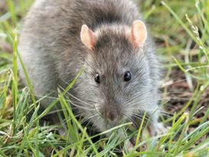
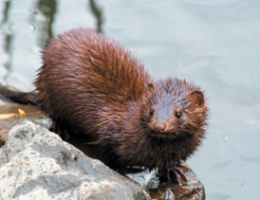
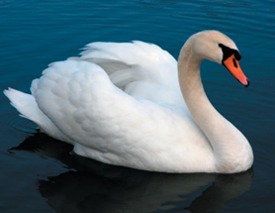
Site 3 – species in the ecosystem
Brown rat
American mink
Grey heron
Common moorhen
Mallard duck
Mute swan
Common roach
North American signal crayfish
Common darter
Image credit: Zeynel Cebeci
Image credit: Chuck Homler
Image credit: Laitche
Image credit: Alexis Lours
Image credit: Richard Bartz
Image credit: Yerpo
yourgenome.org
Image credit: Karelj
Image credit: Astacoides
Image credit: L B Tettenborn

Slide 28
Site 3 – impact on the ecosystem
Which of these species are predators?
American mink, grey heron
Are there any endangered species present?
None at this location
Are there any invasive species?
Brown rat: Outcompeted native black rat, causing their numbers to decline. Can spread disease, impacting native wildlife.
American mink: Species linked to the decline in water vole populations.
North American signal crayfish: Burrow into riverbanks, damaging structure and vegetation. Outcompeted and infected native white-clawed crayfish with fungal disease.
Are any species indicators of good water quality?
None at this location
yourgenome.org

Slide 29
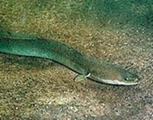
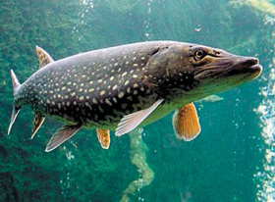
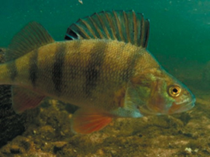
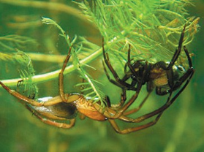
Site 4 – species in the ecosystem
European otter
Mallard duck
Common frog
European eel
Northern pike
European perch
Common roach
Water spider
Emperor dragonfly
Image credit: Bernard Landgraf
Image credit: Richard Bartz
Image credit: Richard Bartz
Image credit: GerardM
Image credit: Jik jik
Image credit: Canal River Trust
yourgenome.org
Image credit: Karelj
Image credit: Baupi
Image credit: Quartl

Slide 30
Site 4 – impact on the ecosystem
Which of these species are predators?
European otter, Northern pike, European perch, water spider
Are there any endangered species present?
European eel
Are there any invasive species?
None at this location
Are any species indicators of good water quality?
None at this location
yourgenome.org

Slide 31
Summary
Old cells are left by an organism in the environment
These old cells still contain DNA and can be collected in eDNA (environmental DNA) samples
DNA can be extracted from eDNA samples and sequenced
Using bioinformatics, DNA sequences can be compared to an online database to identify the species present
Finding the species present in the environment using DNA allows us to study the biodiversity in an area
Knowing about the biodiversity in an area can help us find endangered species, invasive species and learn more about water quality
yourgenome.org

Slide 32
Wild DNA
Investigate eDNA

