Slide 1


Whose Poo?
Match the poo to the animal
Notes:
Teacher notes can be found here throughout the presentation.

Slide 2

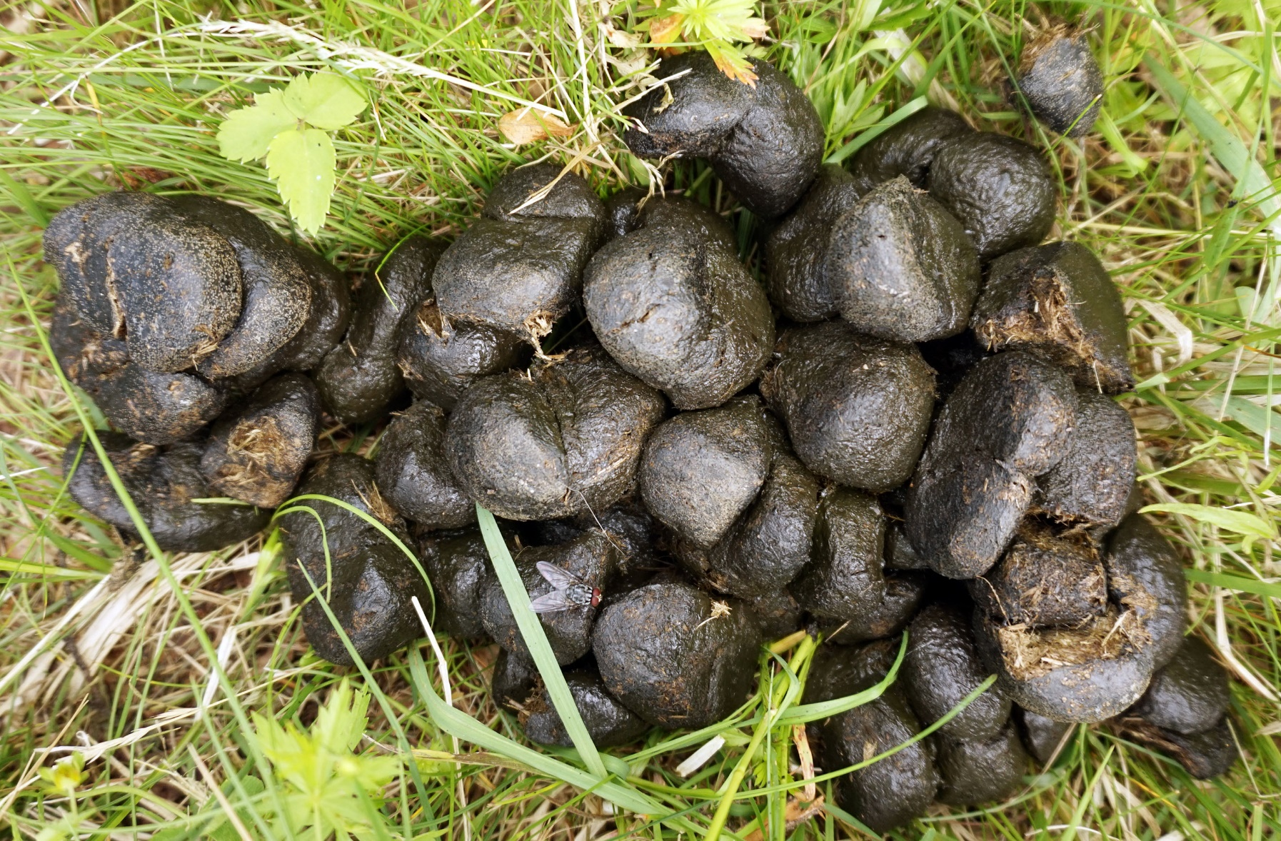

What is it?
Tiia Monto, Wikimedia Commons
yourgenome.org
Notes:
Yes you guessed it – it is poo. Why are we talking about it? Well, it sometimes can be very informative.
We are going to see if you are great Dung detectives and can spot who did the poo!

Slide 3
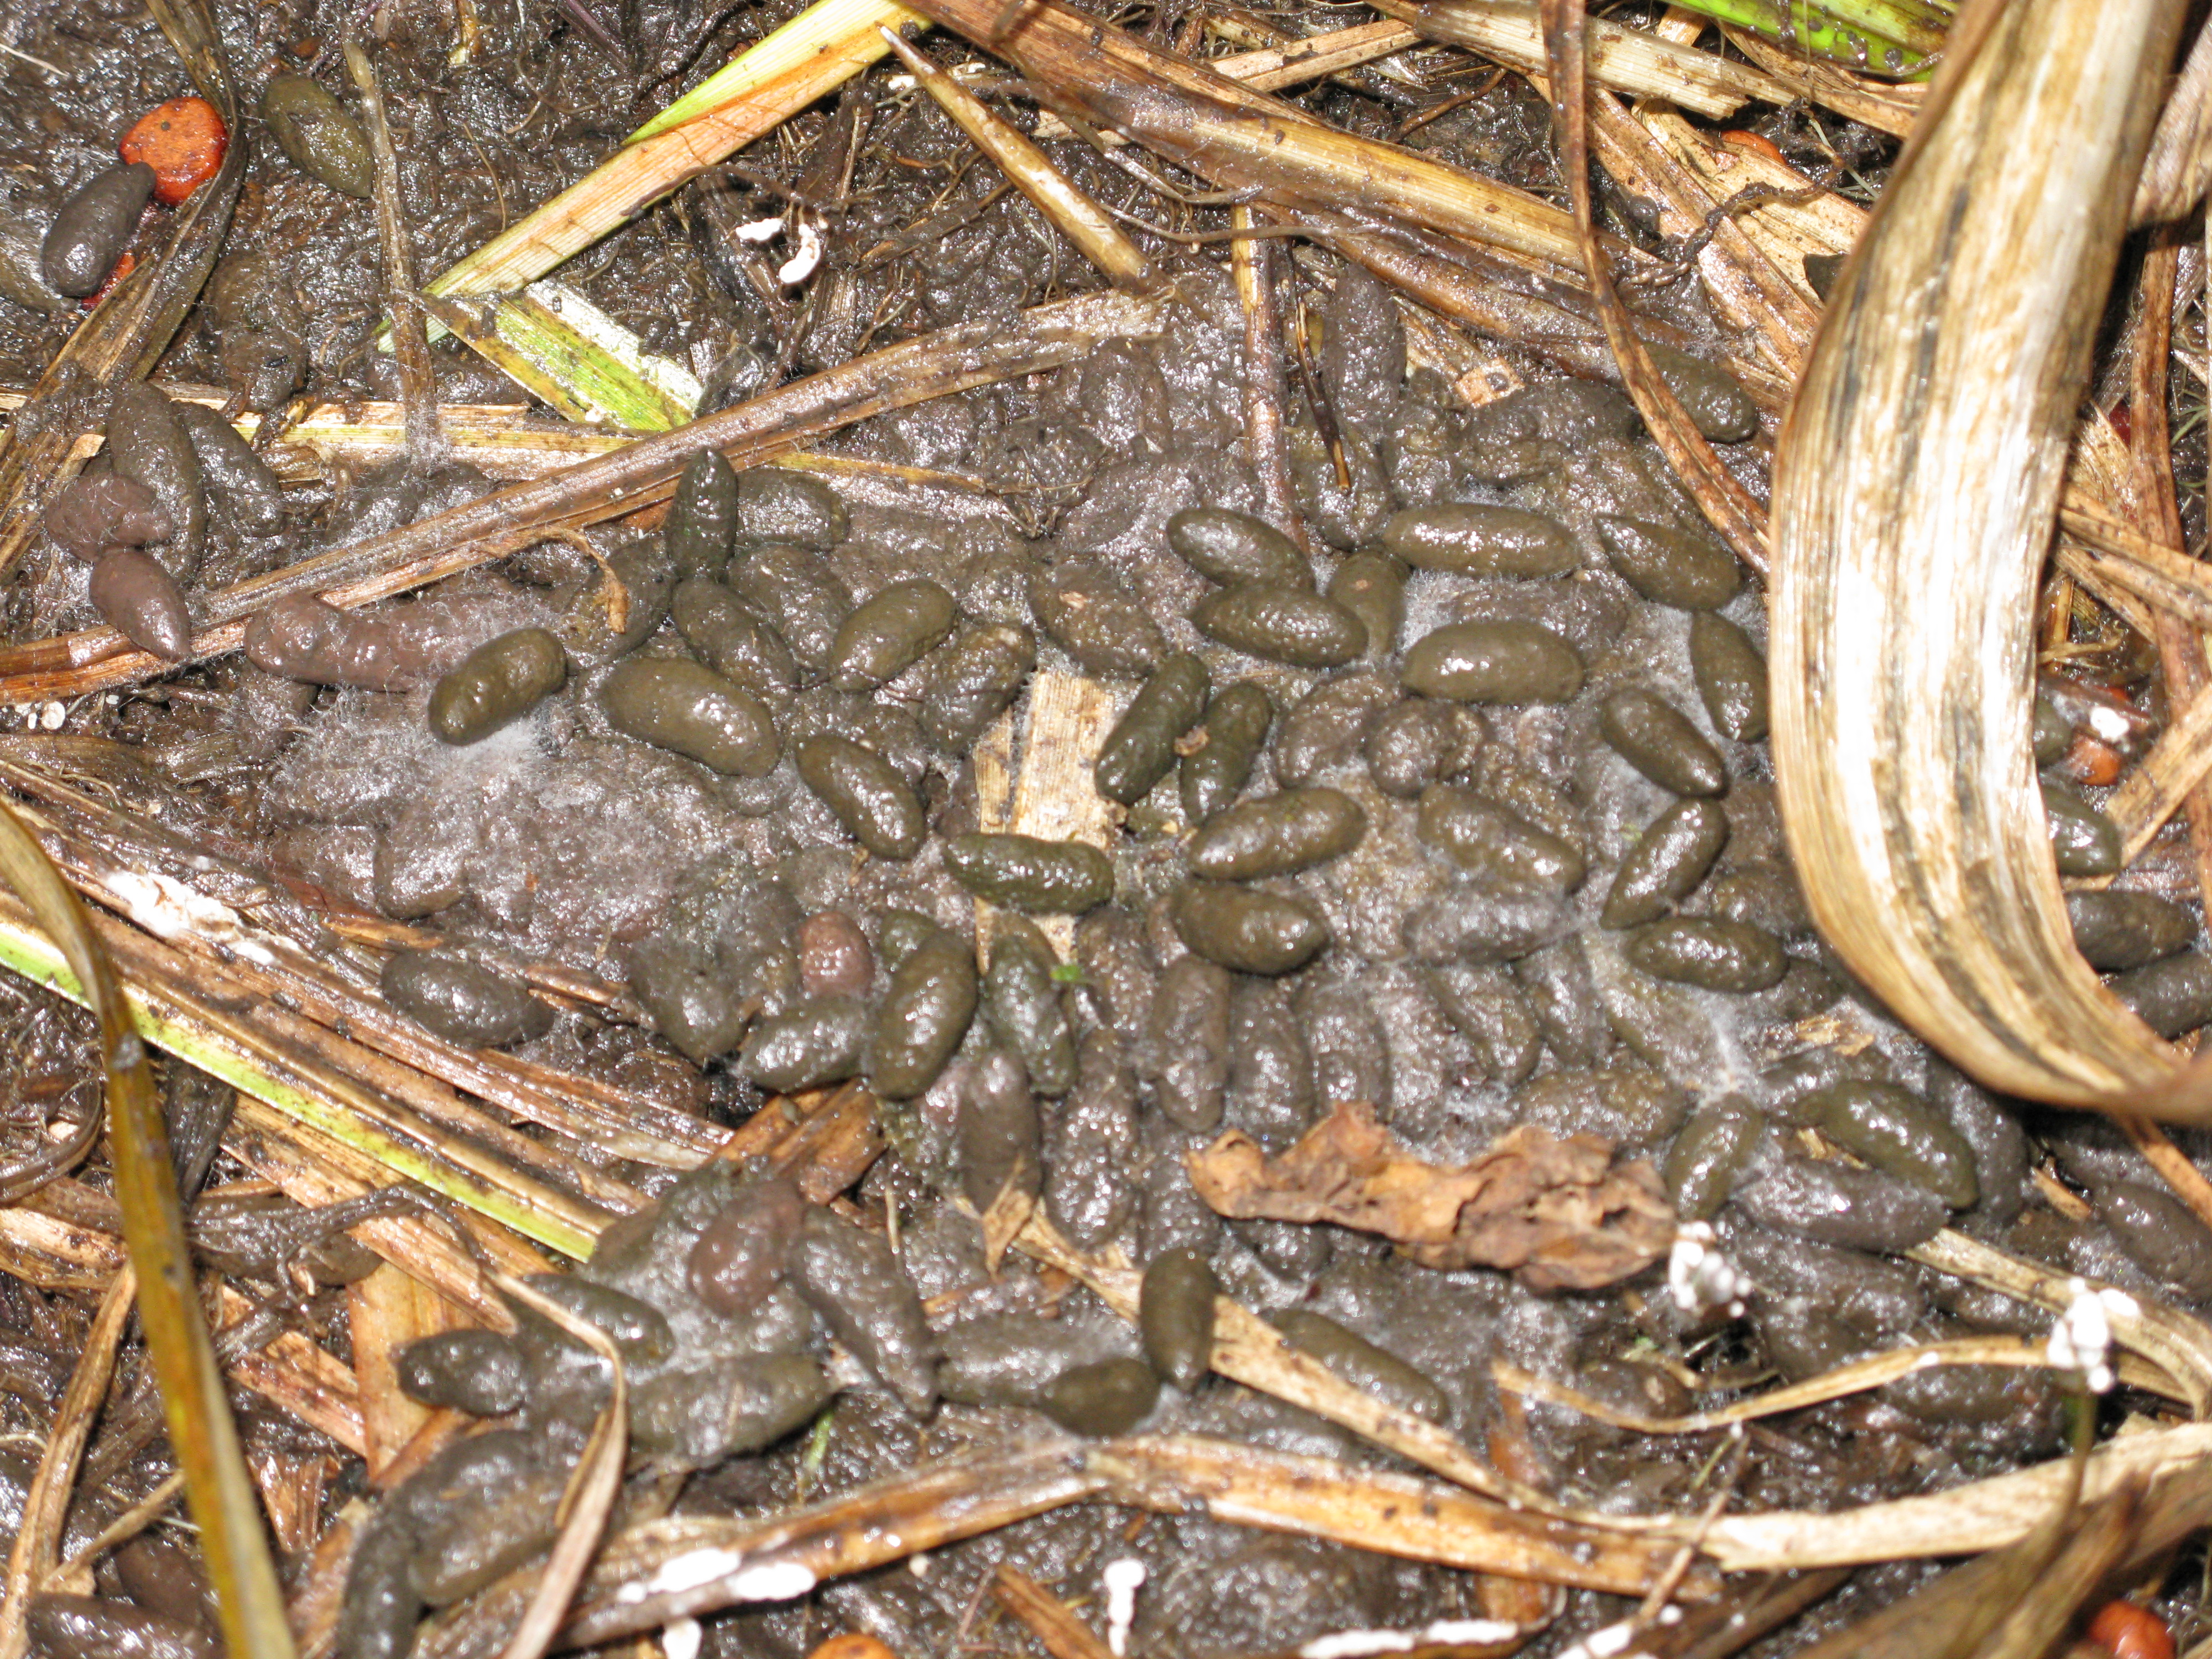
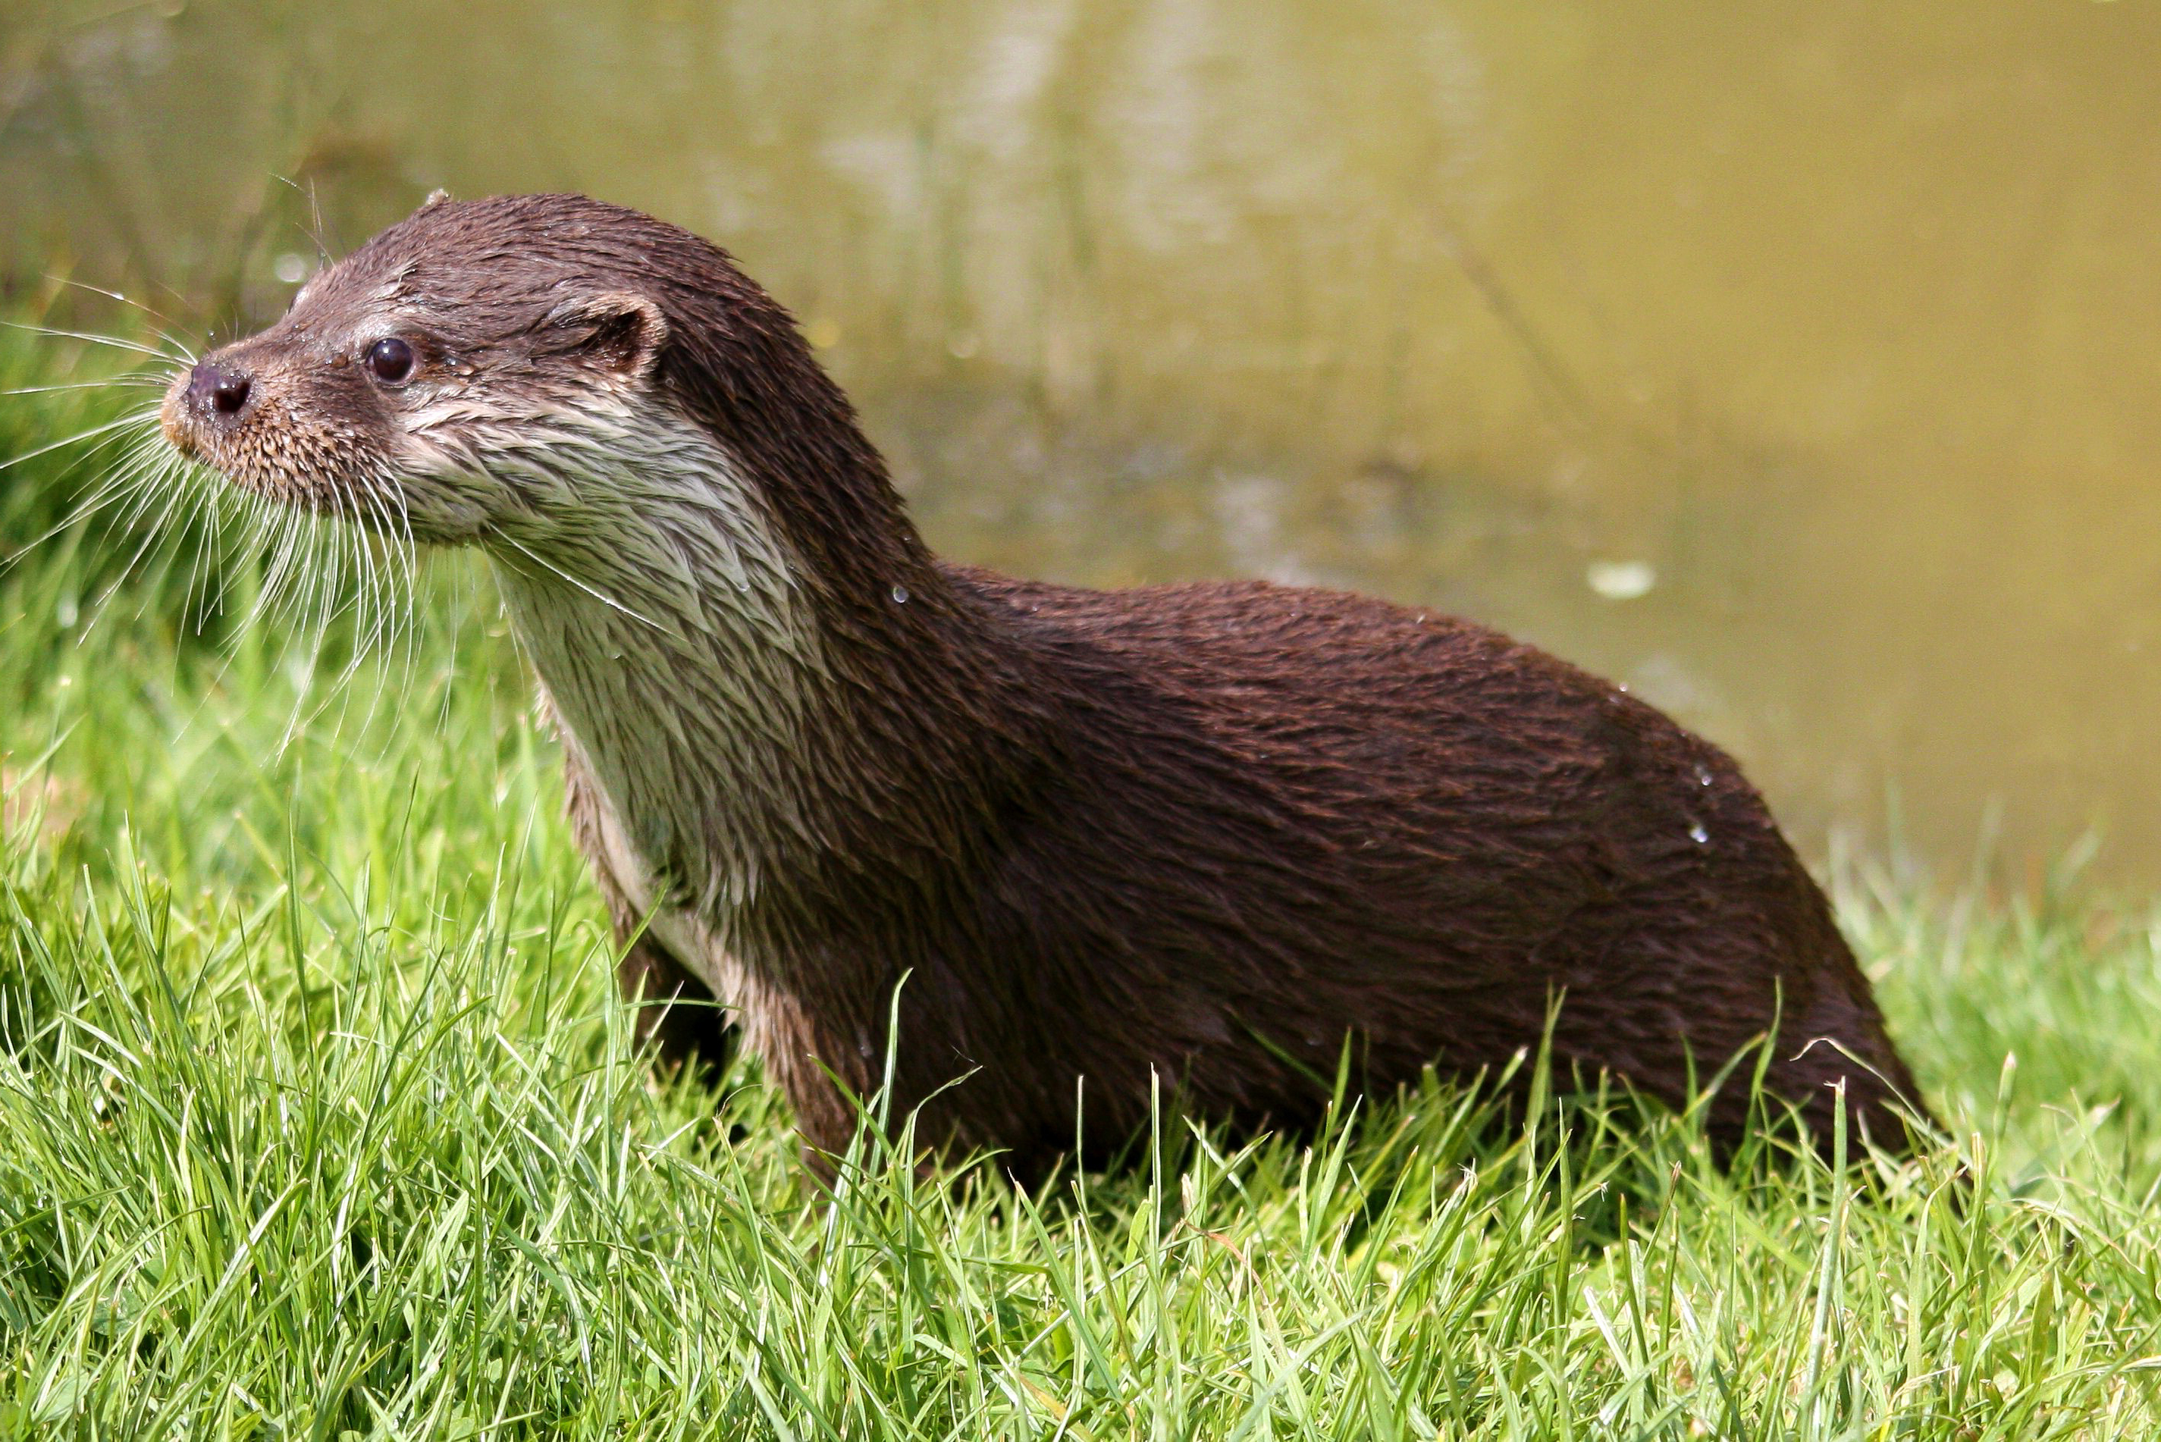
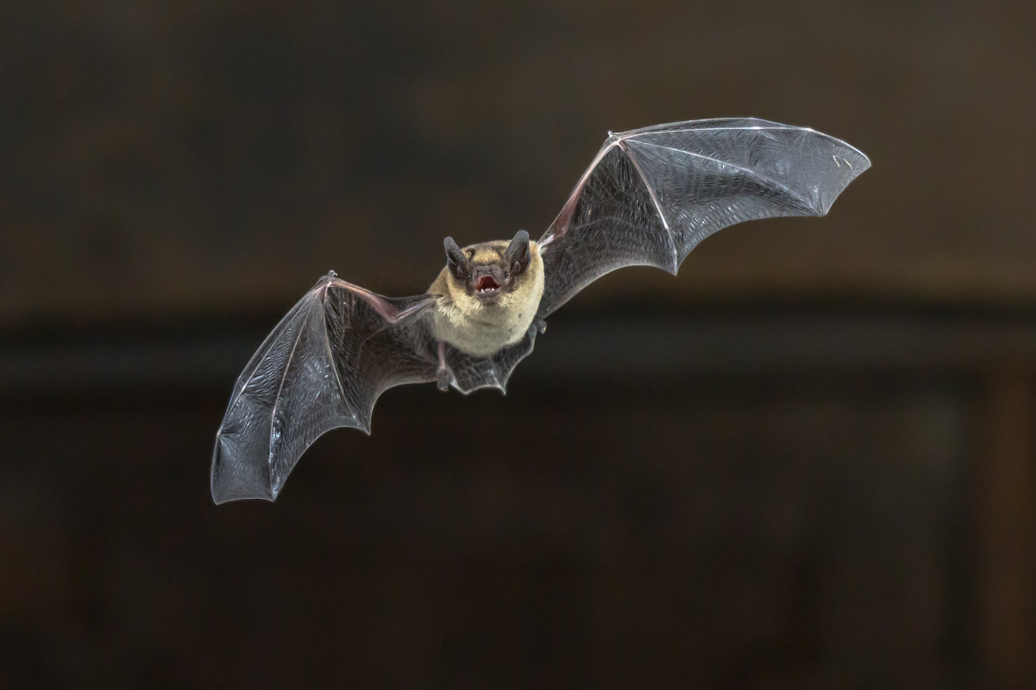
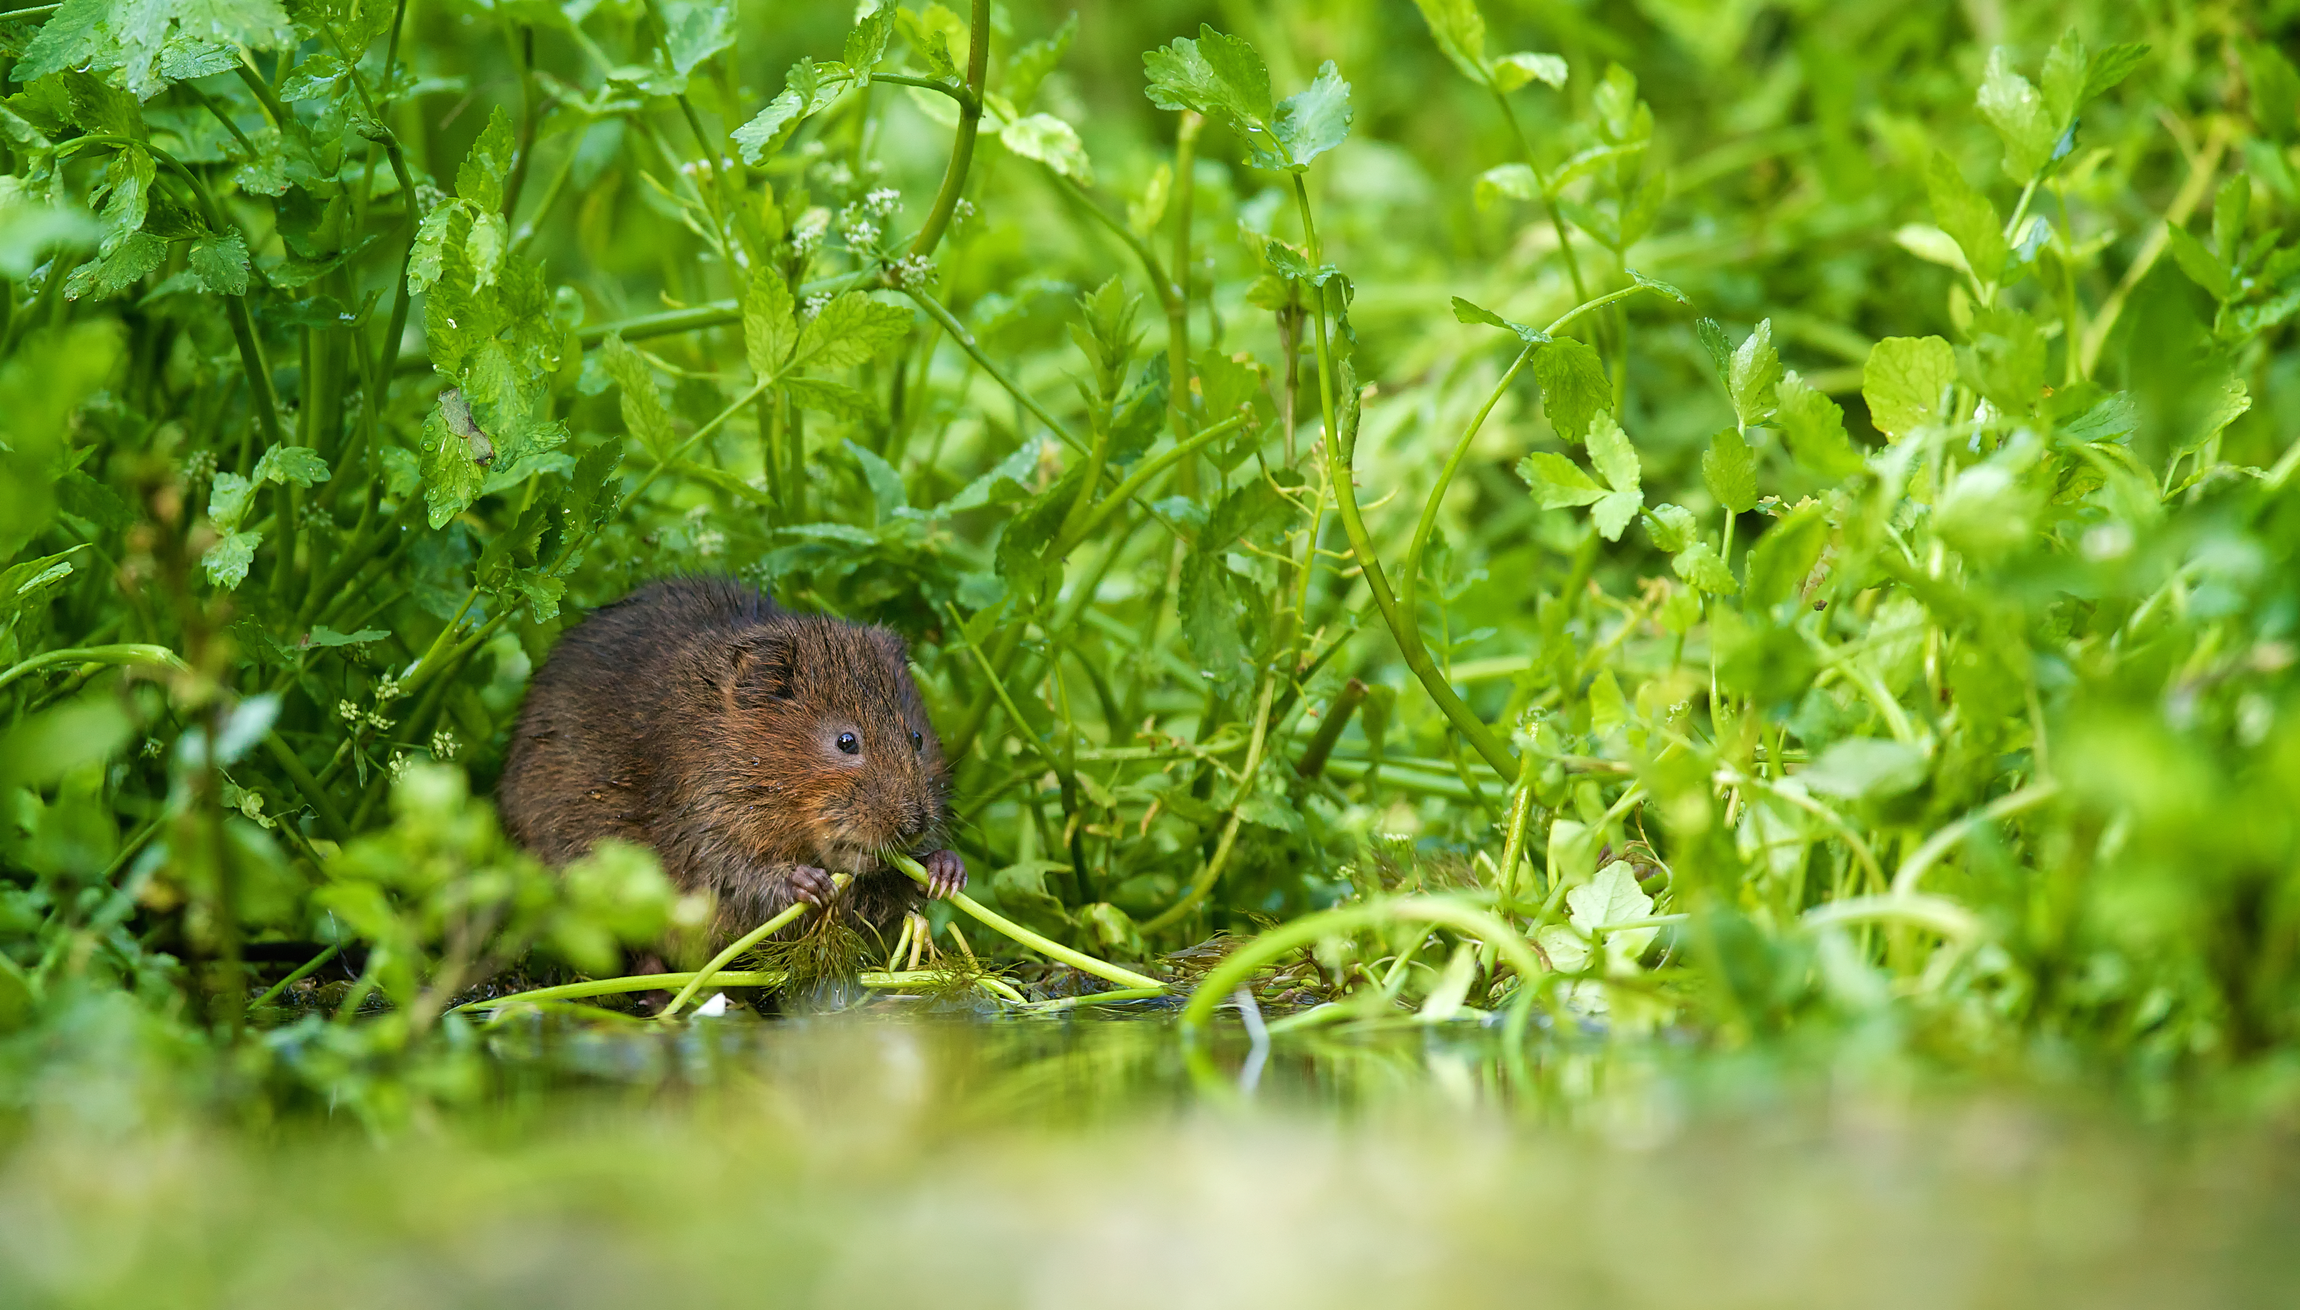
Whose poo?
Eurasian Otter
Common Pipistrelle Bat
yourgenome.org
Darren Tansley
Water Vole
Notes:
Your task is to match the poo to the animal. On your worksheet match the poo to the animal.
Who did the poos?

Slide 4
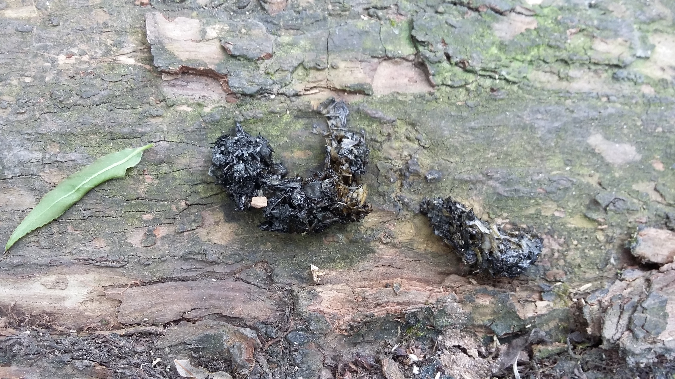
Whose poo?
Eurasian Otter
Common Pipistrelle Bat
yourgenome.org
St Nicks Environment Centre
Water Vole
Notes:
Your task is to match the poo to the animal. On your worksheet match the poo to the animal.
Who did the poos?

Slide 5
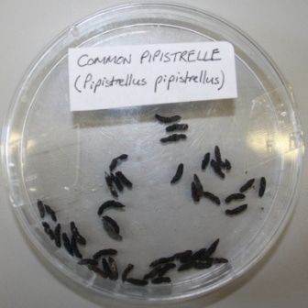
Whose poo?
Eurasian Otter
Common Pipistrelle Bat
yourgenome.org
Acer Ecology
Water Vole
Notes:
Your task is to match the poo to the animal. On your worksheet match the poo to the animal.
Who did the poos?

Slide 6
What do you think poo can tell us?
Where it is living
What species
it is
Tiia Monto, Wikimedia Commons
What it has been eating
Who it is related to
Who it is
yourgenome.org
Notes:
Ask the group if they think poo can be used to tell us anything else about animals?
Poo can tell scientists a lot about an animal for example:
What species it is – distinctive shape and size of poo can identify the species
Where it is living – Some animals use poo to mark their territory, so it can be used to see how far an animal travels.
What it is eating – some foods do not always get digested, so remains are left behind such as beetle body parts, or animal bones.
But what if you can’t see food remains? Can you still find out?
You can by extracting DNA! DNA from poo can tell you quite a few things:
Who it is – Every living thing has DNA and it is unique to that individual. So using techniques , a bit like the forensics used by police, DNA can identify individual animals.
Who are they related to – DNA can also tell scientists if the animal is related to other animals in the area. Animals inherit their DNA from their parents (they get one copy of their genome from mum and the other copy from Dad) so it is possible to use DNA to work out how related animals are.
But what is DNA, does anyone know?

Slide 7

What is DNA?
yourgenome.org
Notes:
DNA or deoxyribonucleic acid is a long molecule that encodes our genetic instructions. All living things have DNA: Animals, plants, fungi, bacteria and viruses!
DNA has a distinctive double helix shape, like a twisted ladder. Two strands of DNA are twisted together into the double helix shape.
The rungs on the DNA ladder are called base pairs: these do the important job of being the instructions.
There are four bases which are complementary meaning that they always pair together. These are represented by four letters: A, C, T and G.

Slide 8
What can DNA from poo really do?
A two year study of a group of bats revealed that they were eating 130 different species of insects.
All from DNA in their poo!
yourgenome.org

Slide 9
What can DNA from poo really do?
DNA from otter spraint can be analysed to identify individual otters.
This can be used to estimate the number of otters in one area.
yourgenome.org

Slide 10
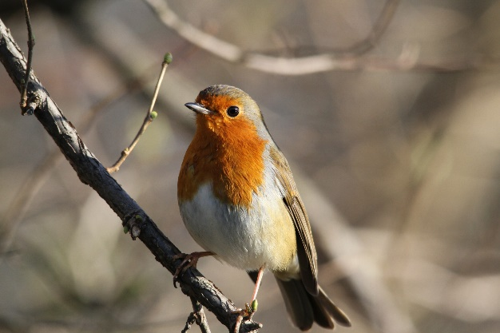
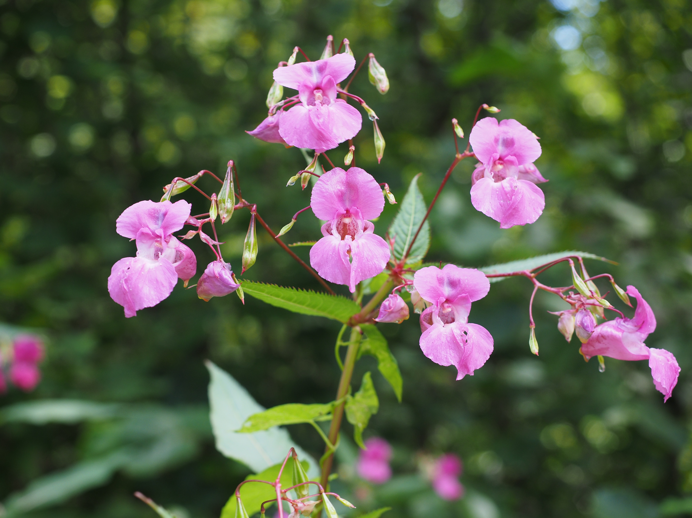
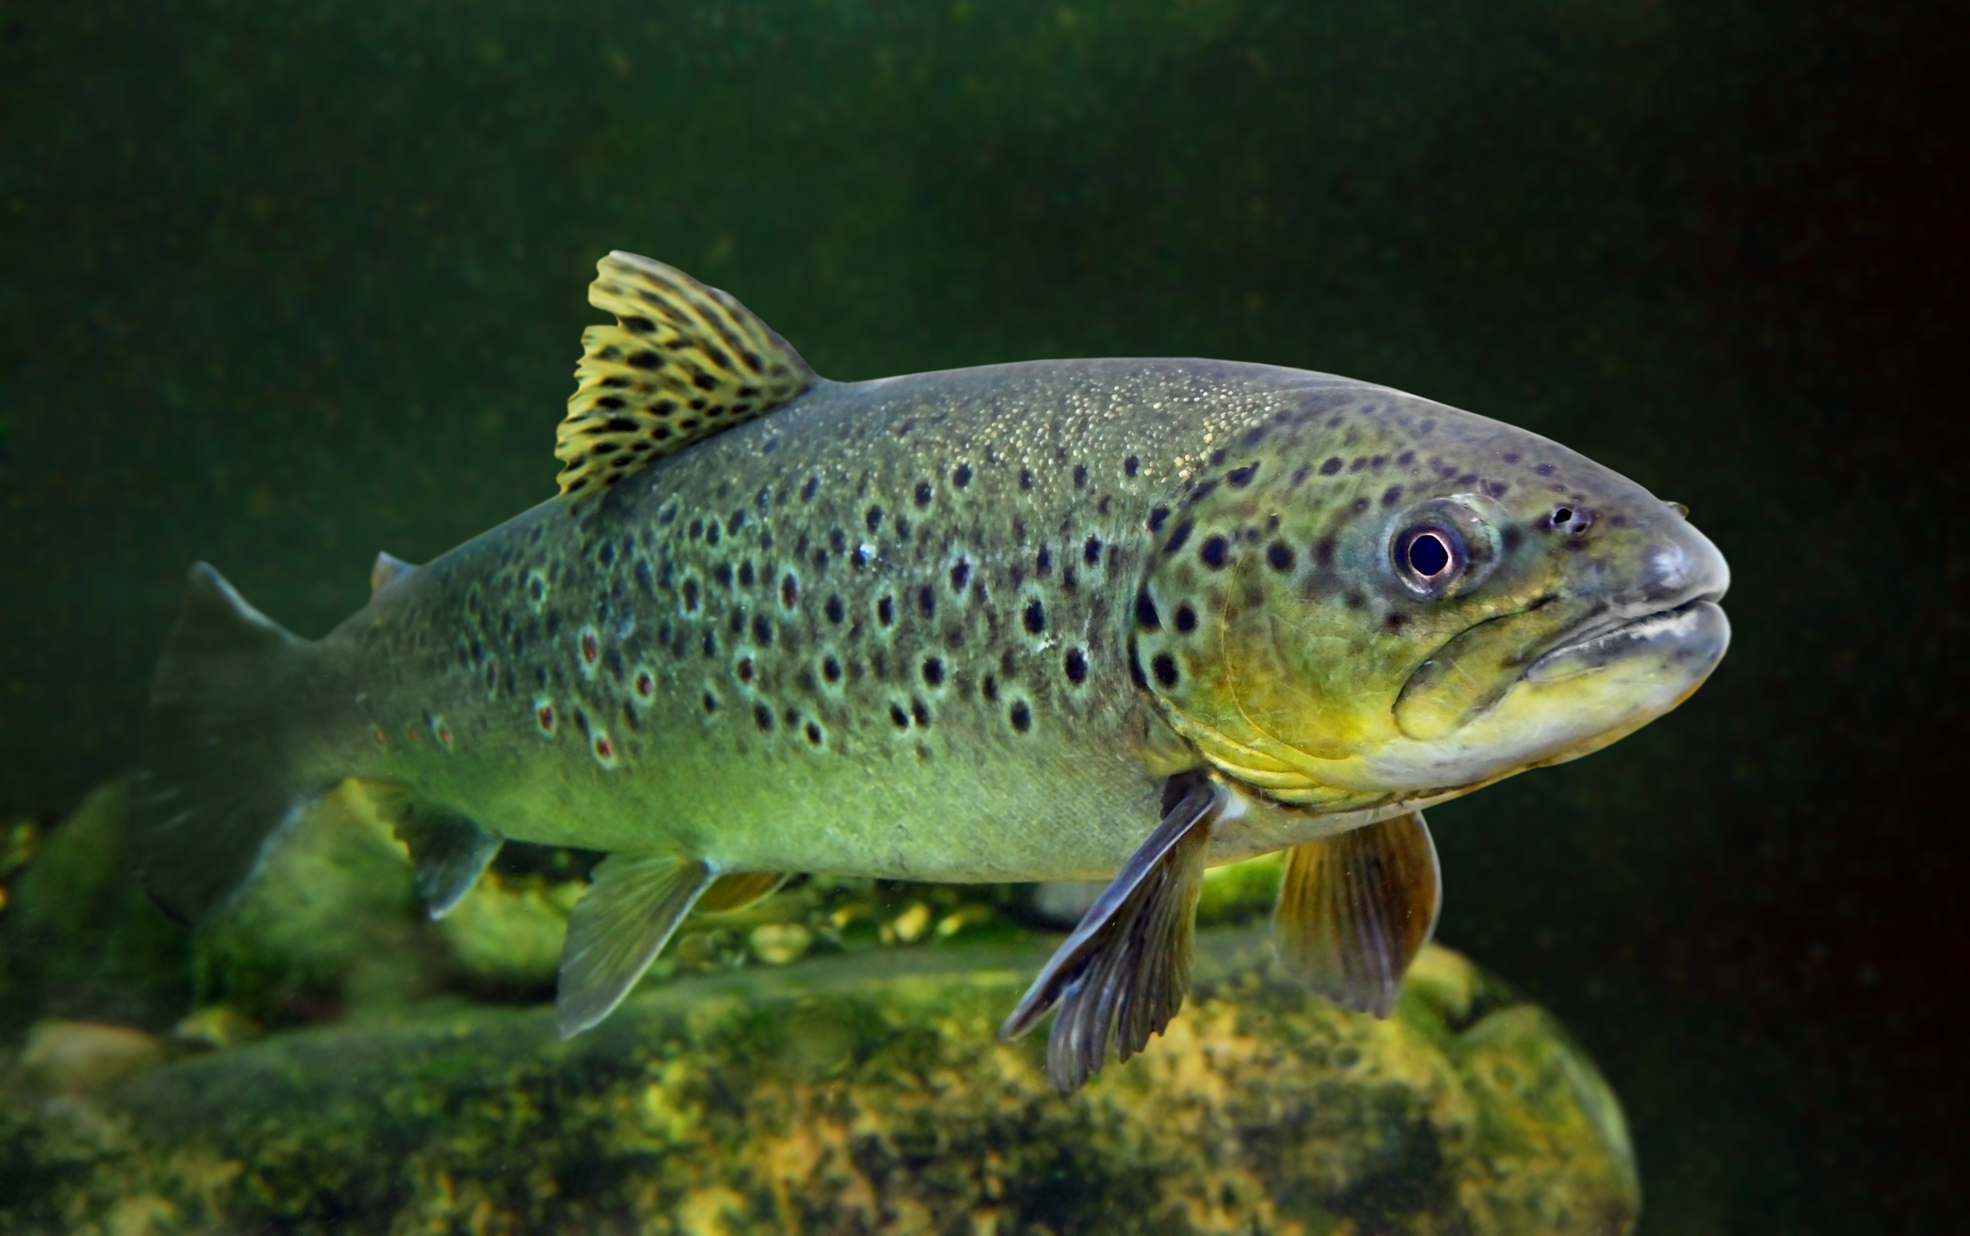
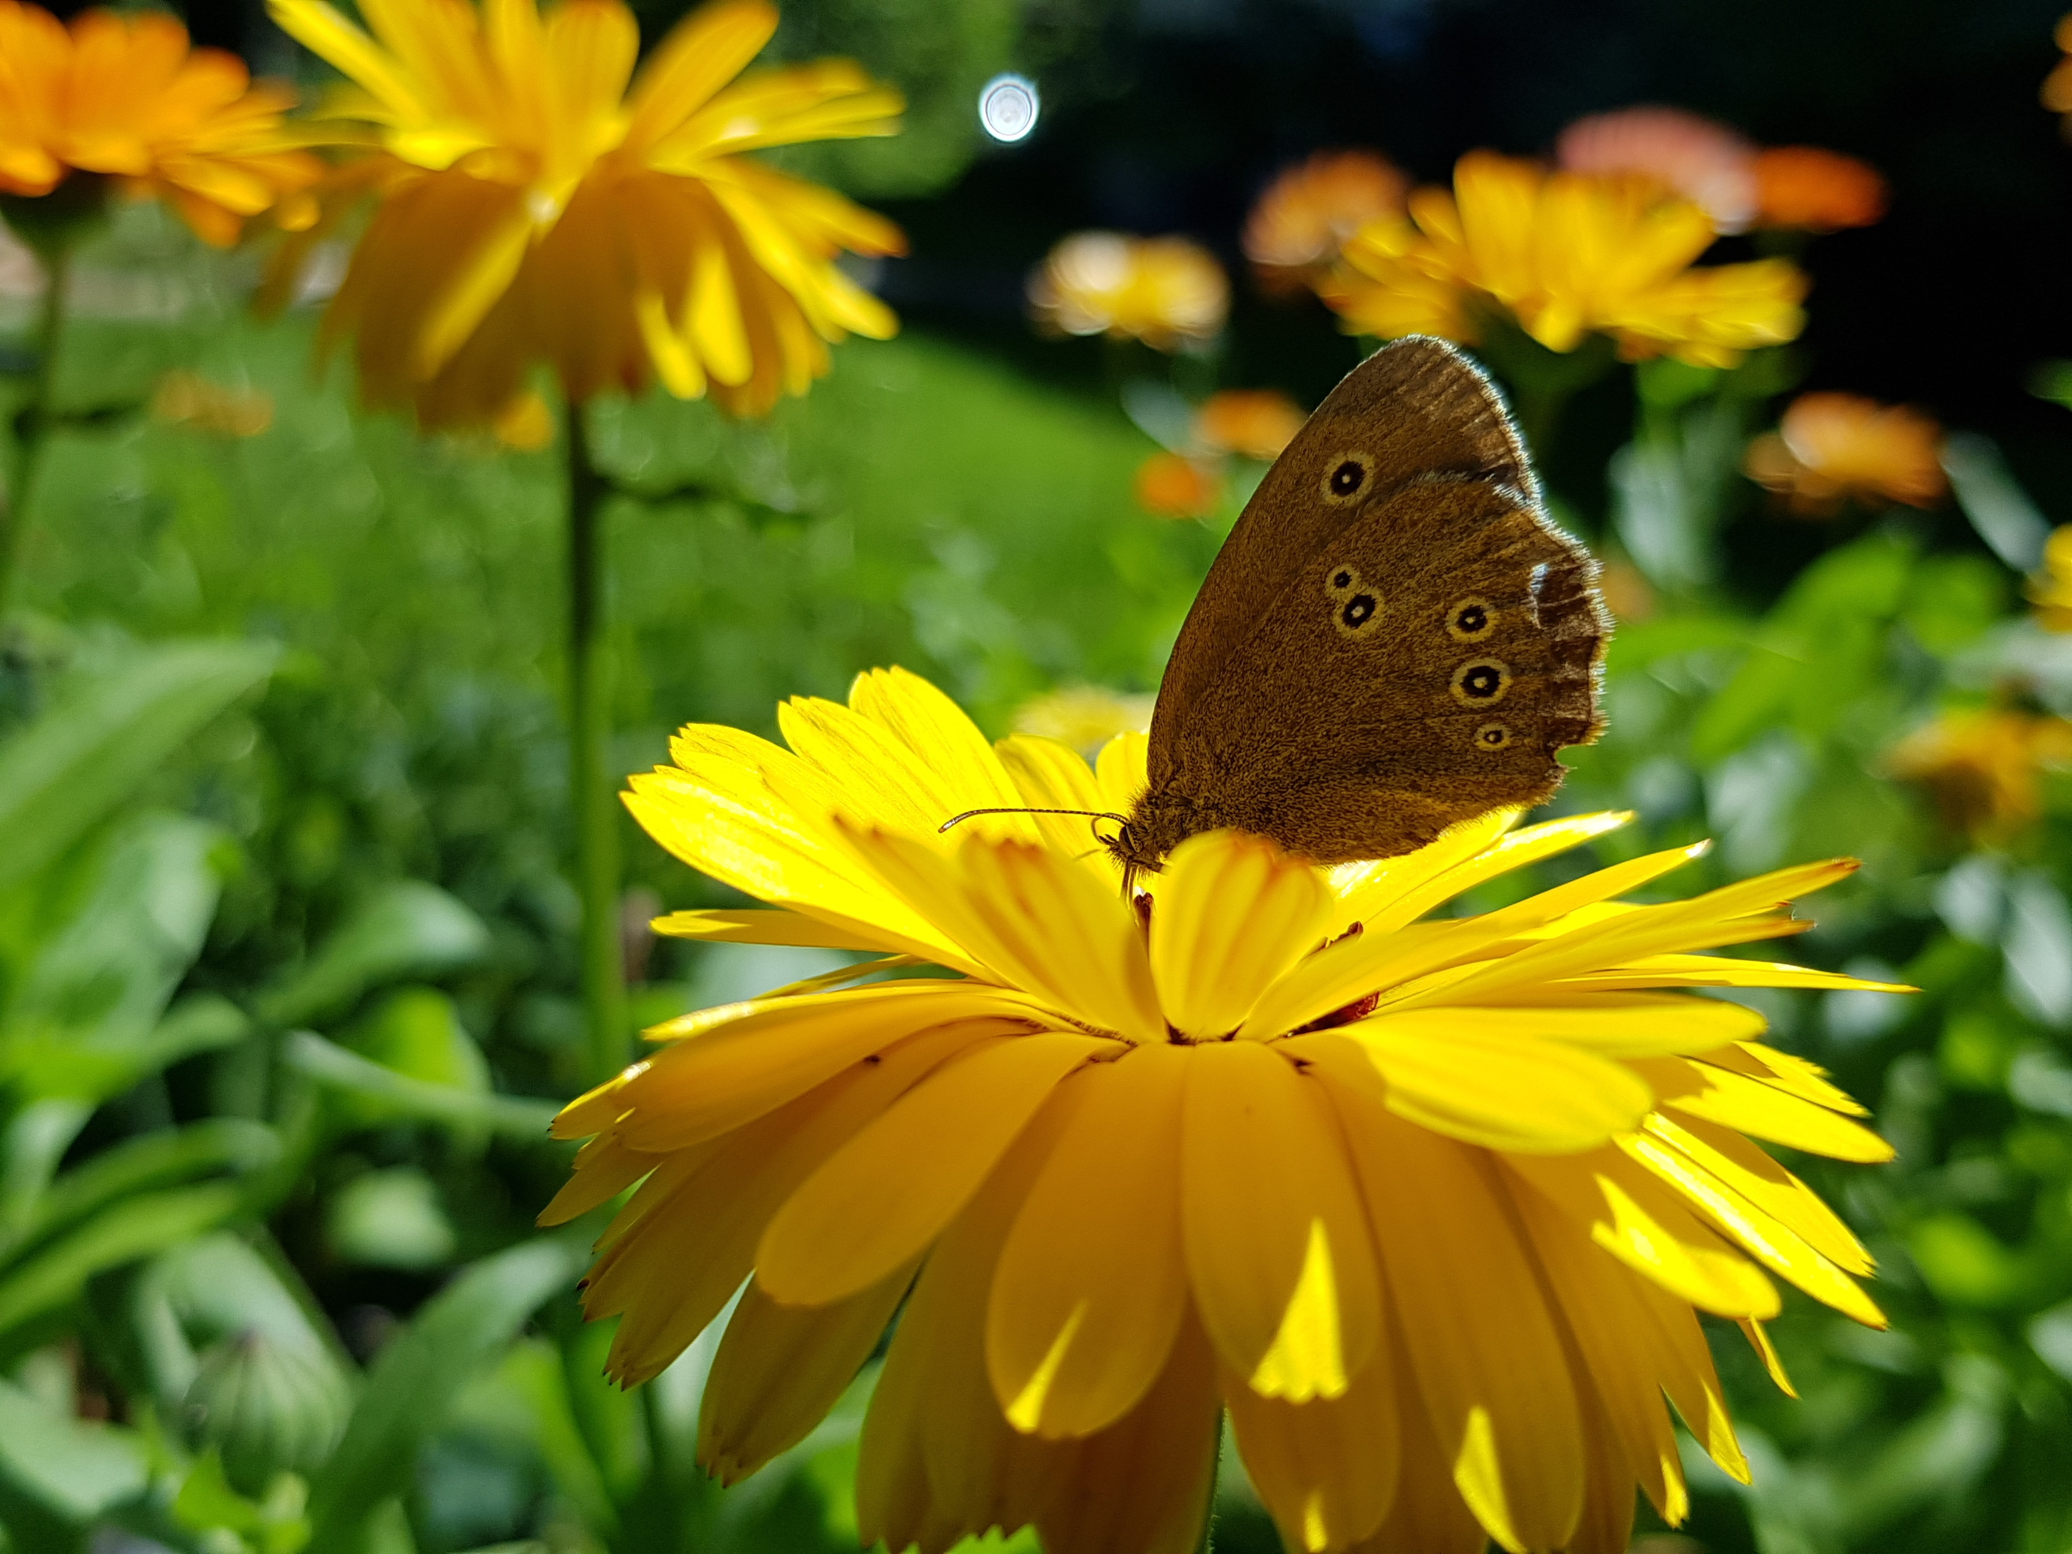
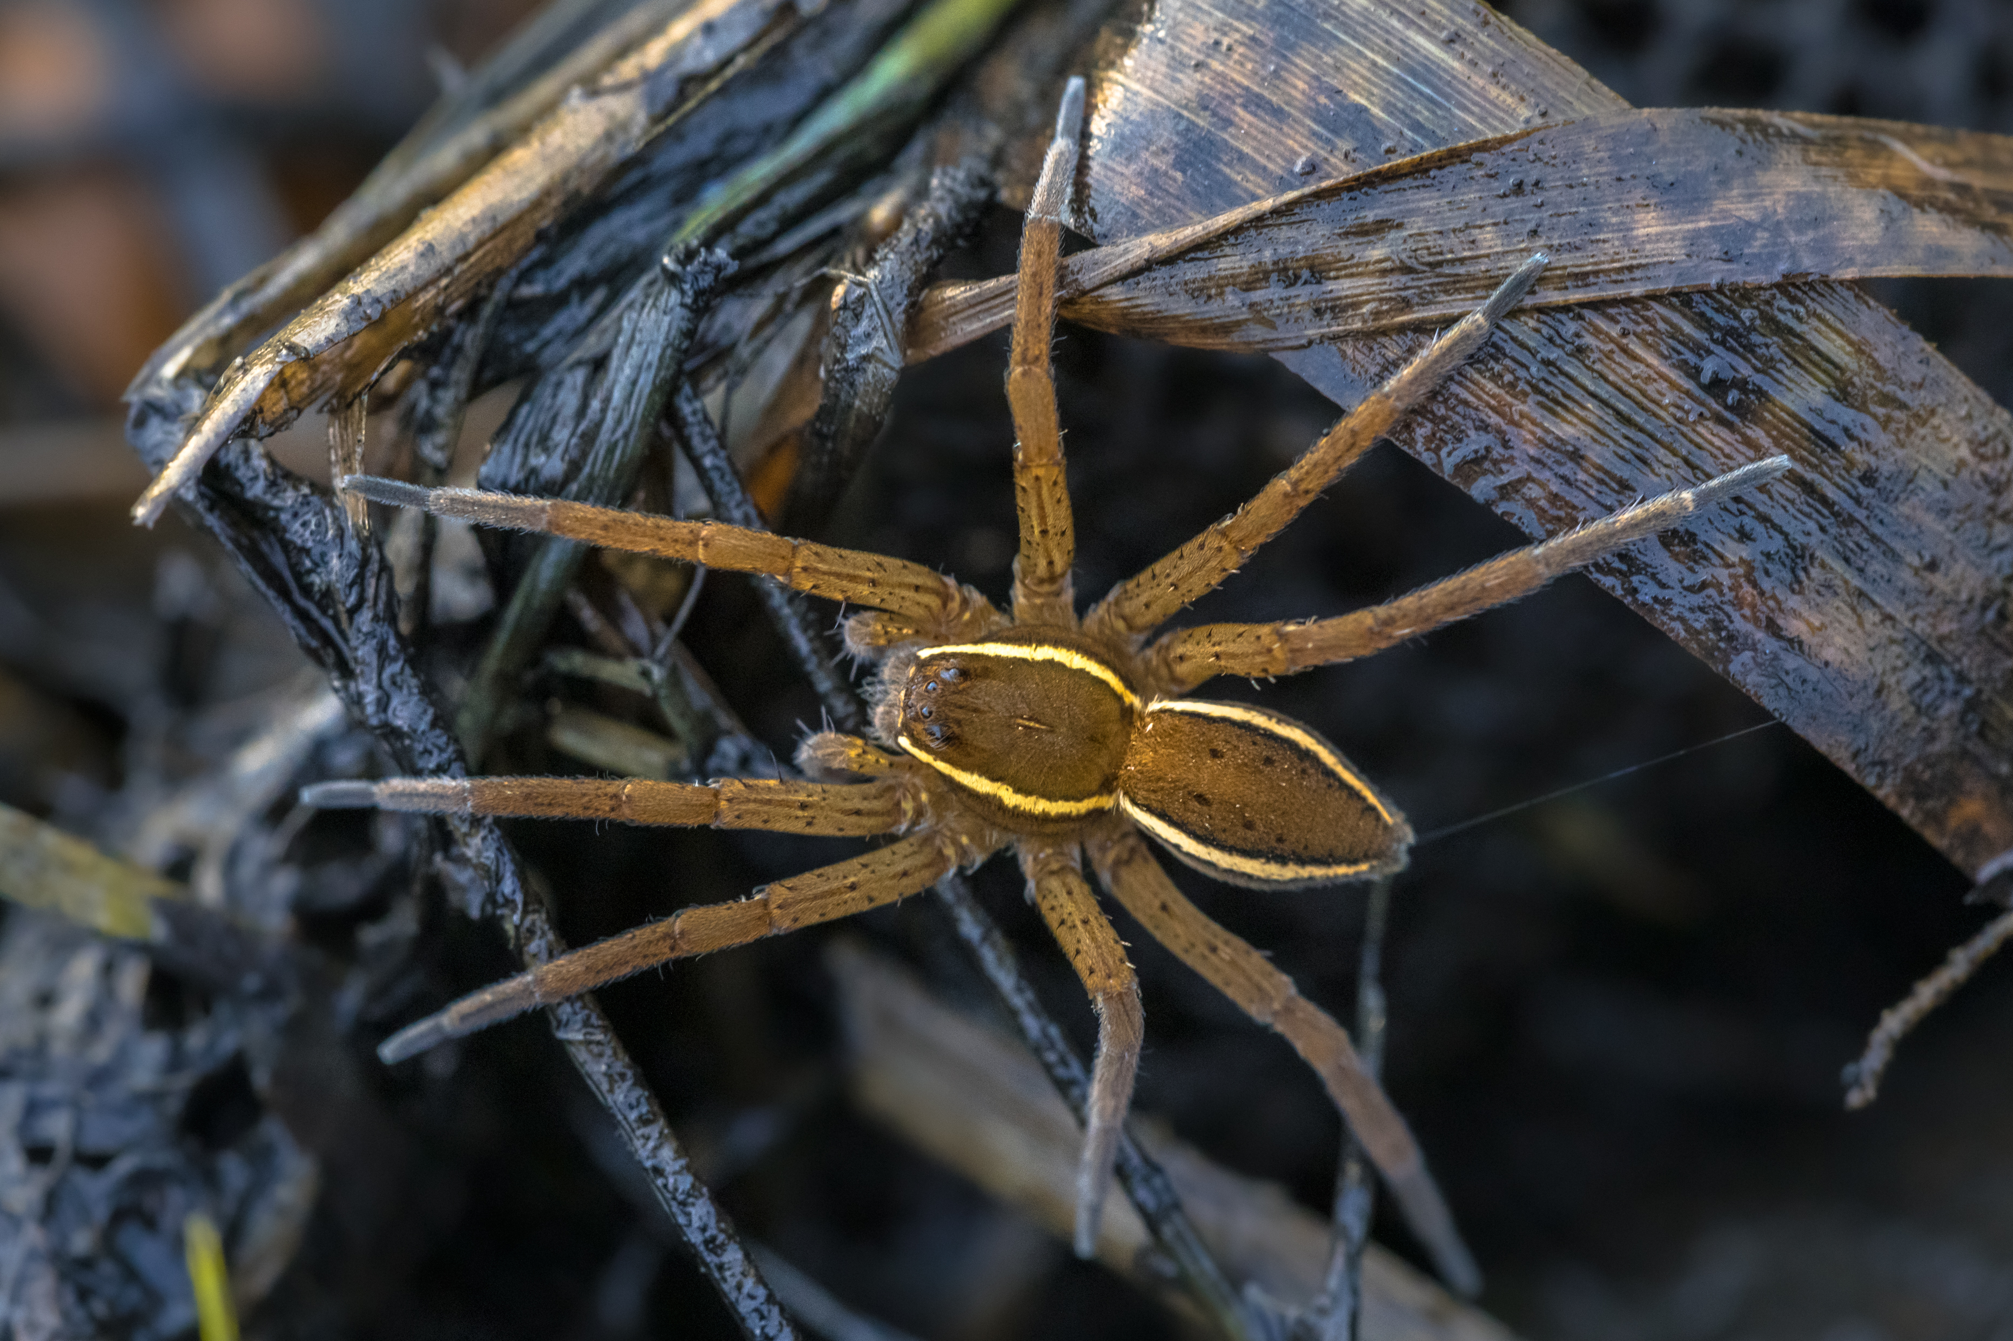
All living things have DNA
yourgenome.org
Notes:
All living things have DNA, Animals such as Robins, Squirrels, Trout, Butterflies and Spiders. Plants and fungi also have DNA.

