Slide 1


Micropipetting
Mastering an essential laboratory skill

Slide 2

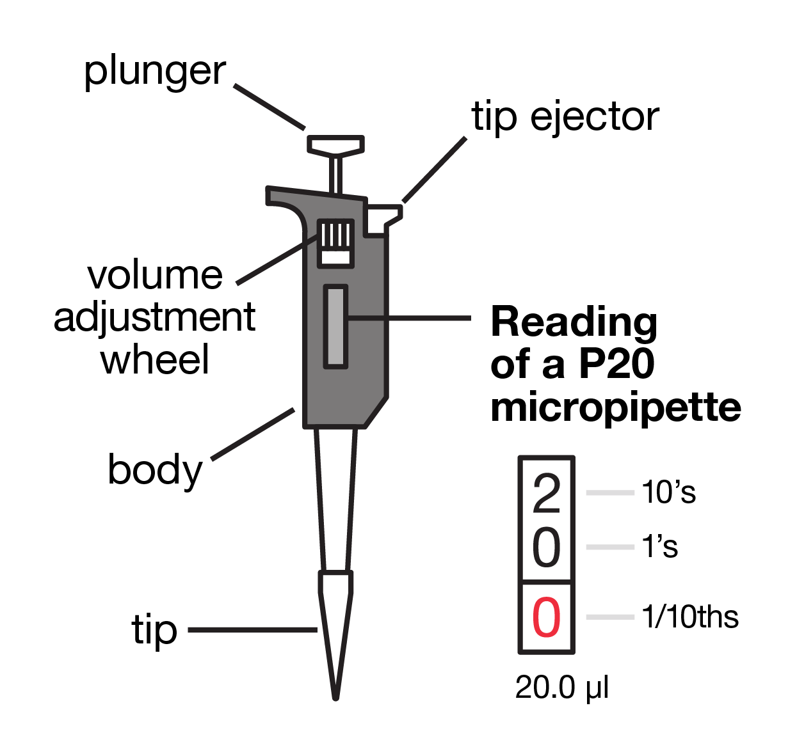

Micropipettes
Scientists often use tiny volumes of liquids in the lab
Volumes are measured in microlitres (µL) – 1/1000th of a millilitre (mL)
To accurately and precisely measure these volumes, scientists use micropipettes
yourgenome.org

Slide 3
Parts of a micropipette
A disposable tip – used for each individual sample
The body – including the handle to grip
A volume adjustment wheel – used to alter the specific volume of the micropipette
yourgenome.org

Slide 4
Parts of a micropipette
A display window – to show the volume the micropipette is set to
A plunger – used to aspirate (suck up) and then dispense the required volume
A tip ejector – used to eject the used tip into the designated waste disposal container
yourgenome.org

Slide 5
Micropipettes - volume
This P20 micropipette is set to a volume of 20.0 µL
In the display window:
The largest number will be tens of microlitres
The second digit will be single units of microlitres
The third digit (in red) will show tenths of a microlitre
yourgenome.org

Slide 6
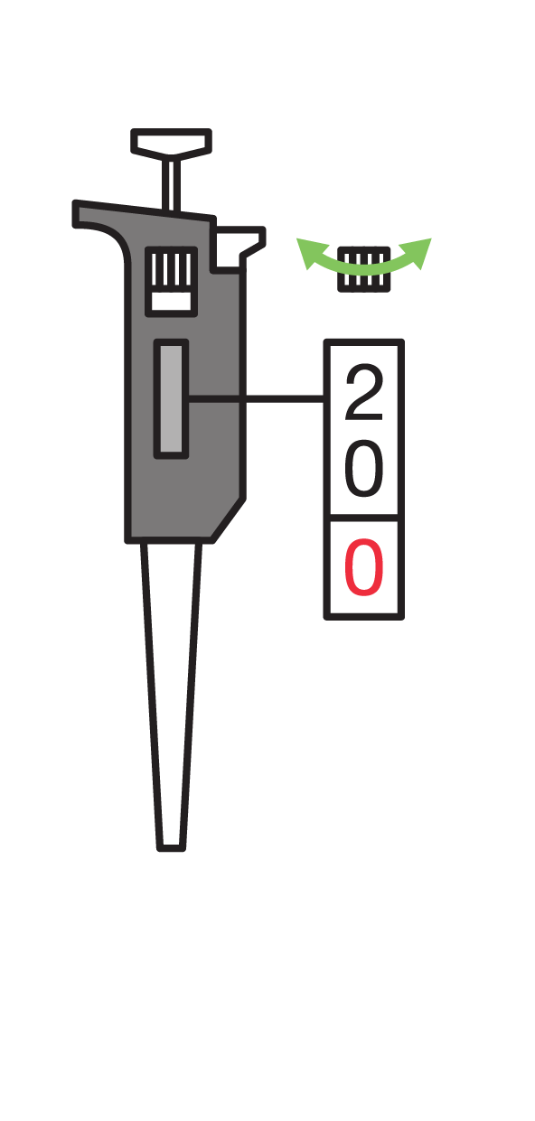
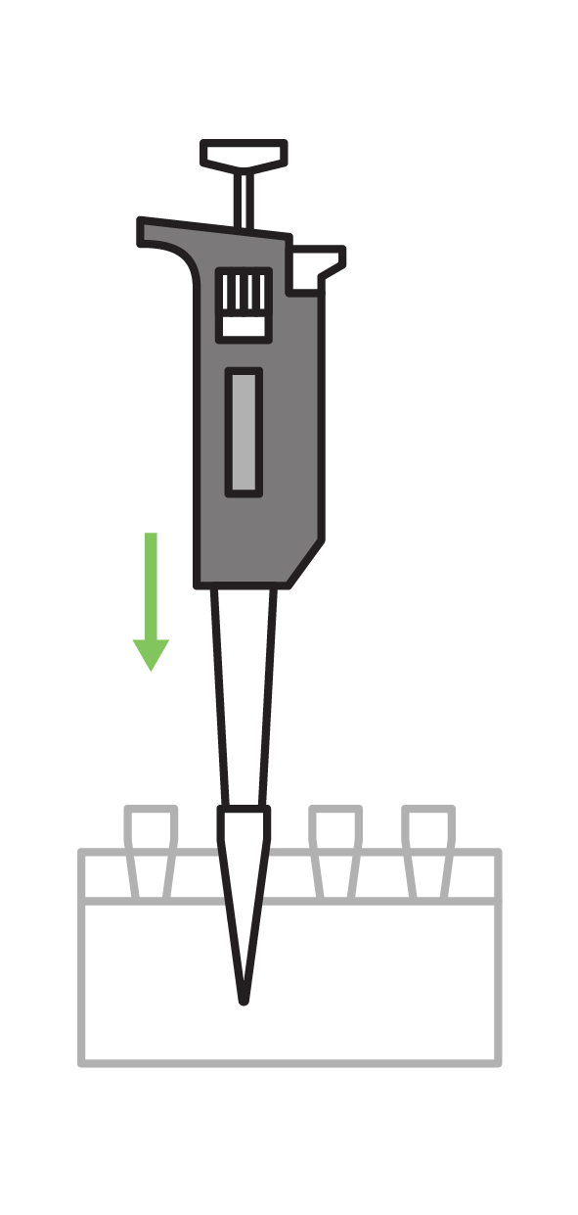
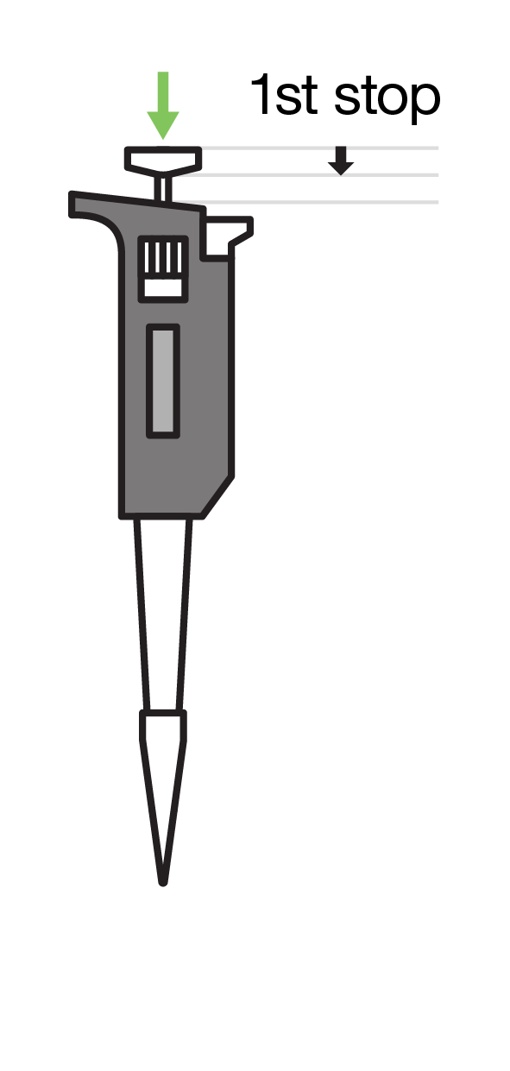
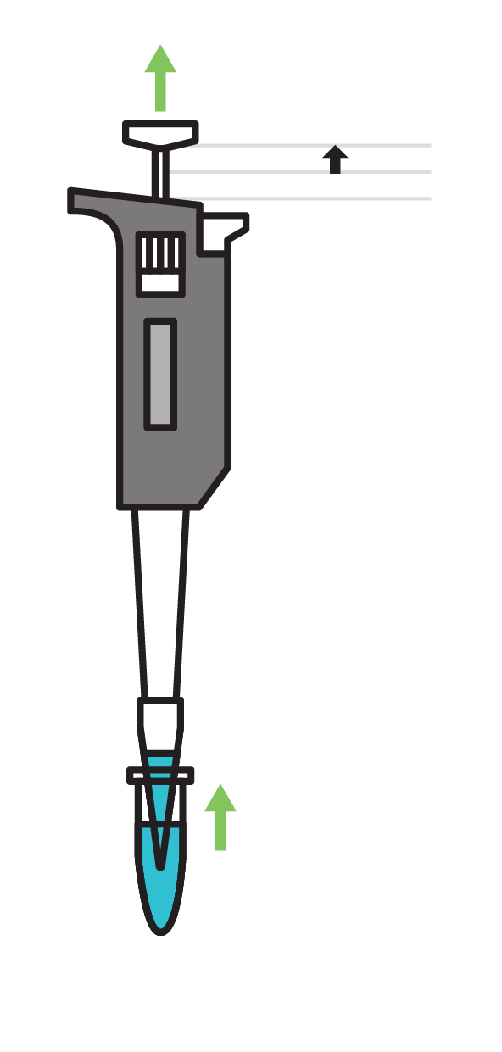
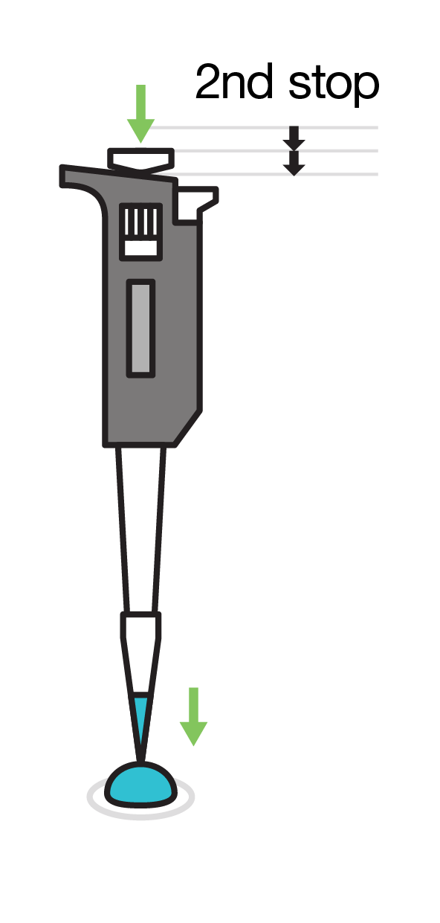
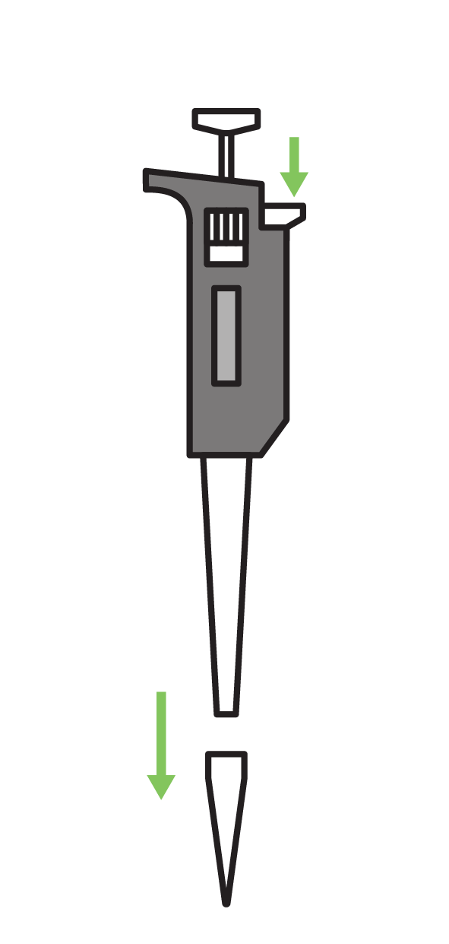
Using a micropipette
A
B
C
Set the volume
Put on the tip
Press plunger to first resistance
Insert tip into the solution and slowly release plunger to aspirate
Place tip ready to dispense, press and hold plunger right down
Remove tip from the liquid, then release plunger and eject tip
D
E
F
yourgenome.org

Slide 7
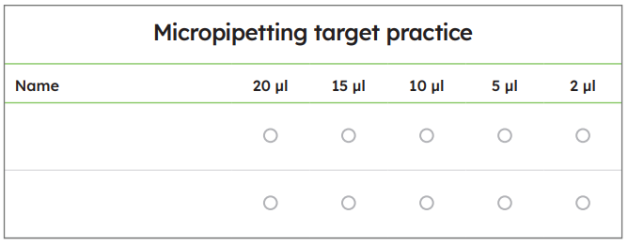
Micropipetting target practice
Use the micropipette to accurately dispense food dye into the centre of the circles on the laminated micropipetting target practice sheet in the volumes shown:
yourgenome.org

Slide 8
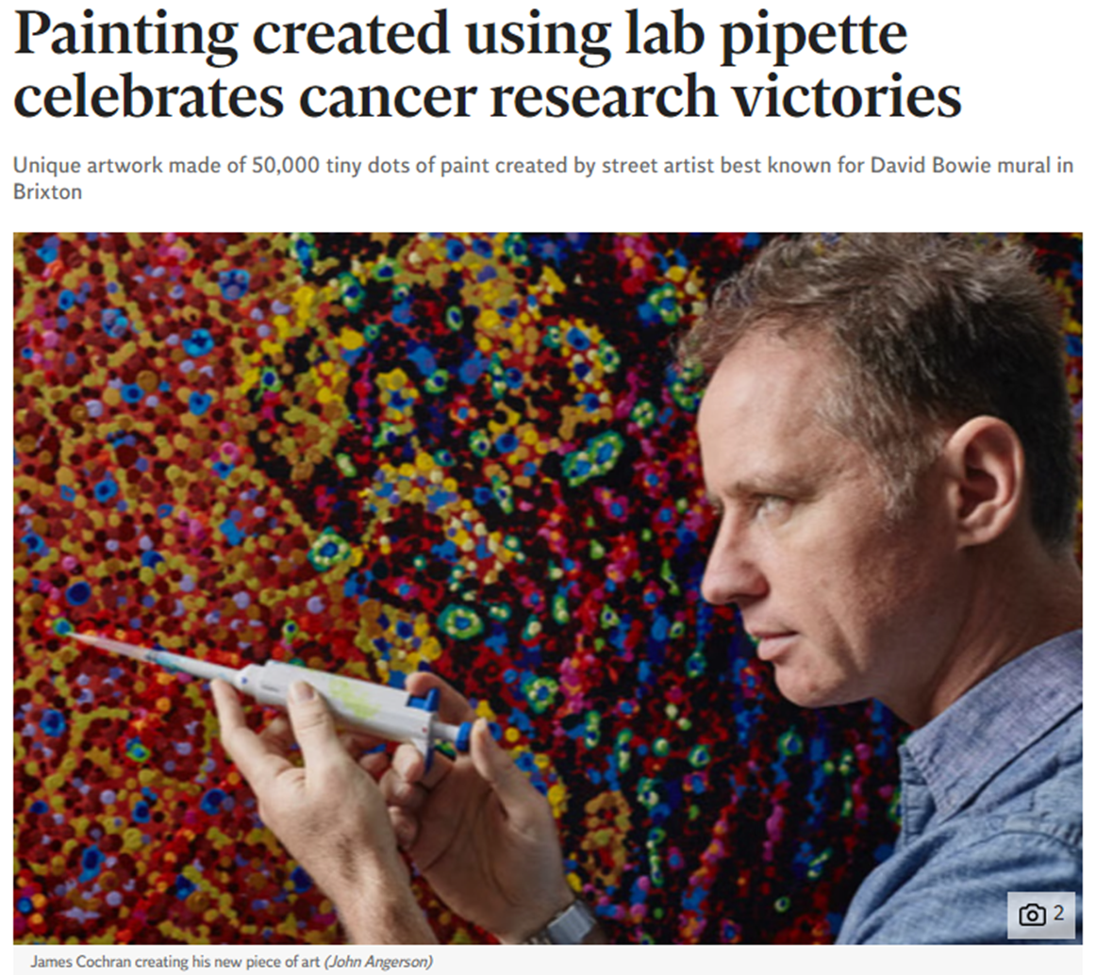
Pipette pointillism
James Cochran, an artist who suffered from a form of skin cancer called basal cell carcinoma, created an image of a cell dividing, using 50,000 tiny dots of paint from a lab pipette
Article written by: Joe Middleton; www.independent.co.uk
Image credit: John Angerson
yourgenome.org

Slide 9
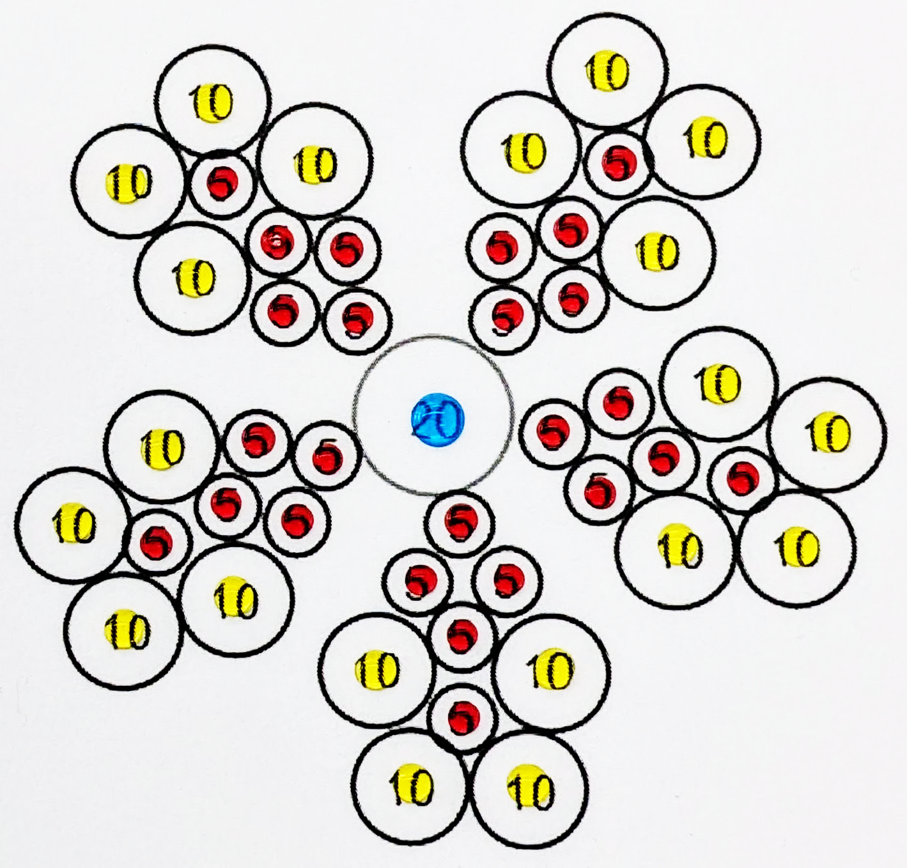
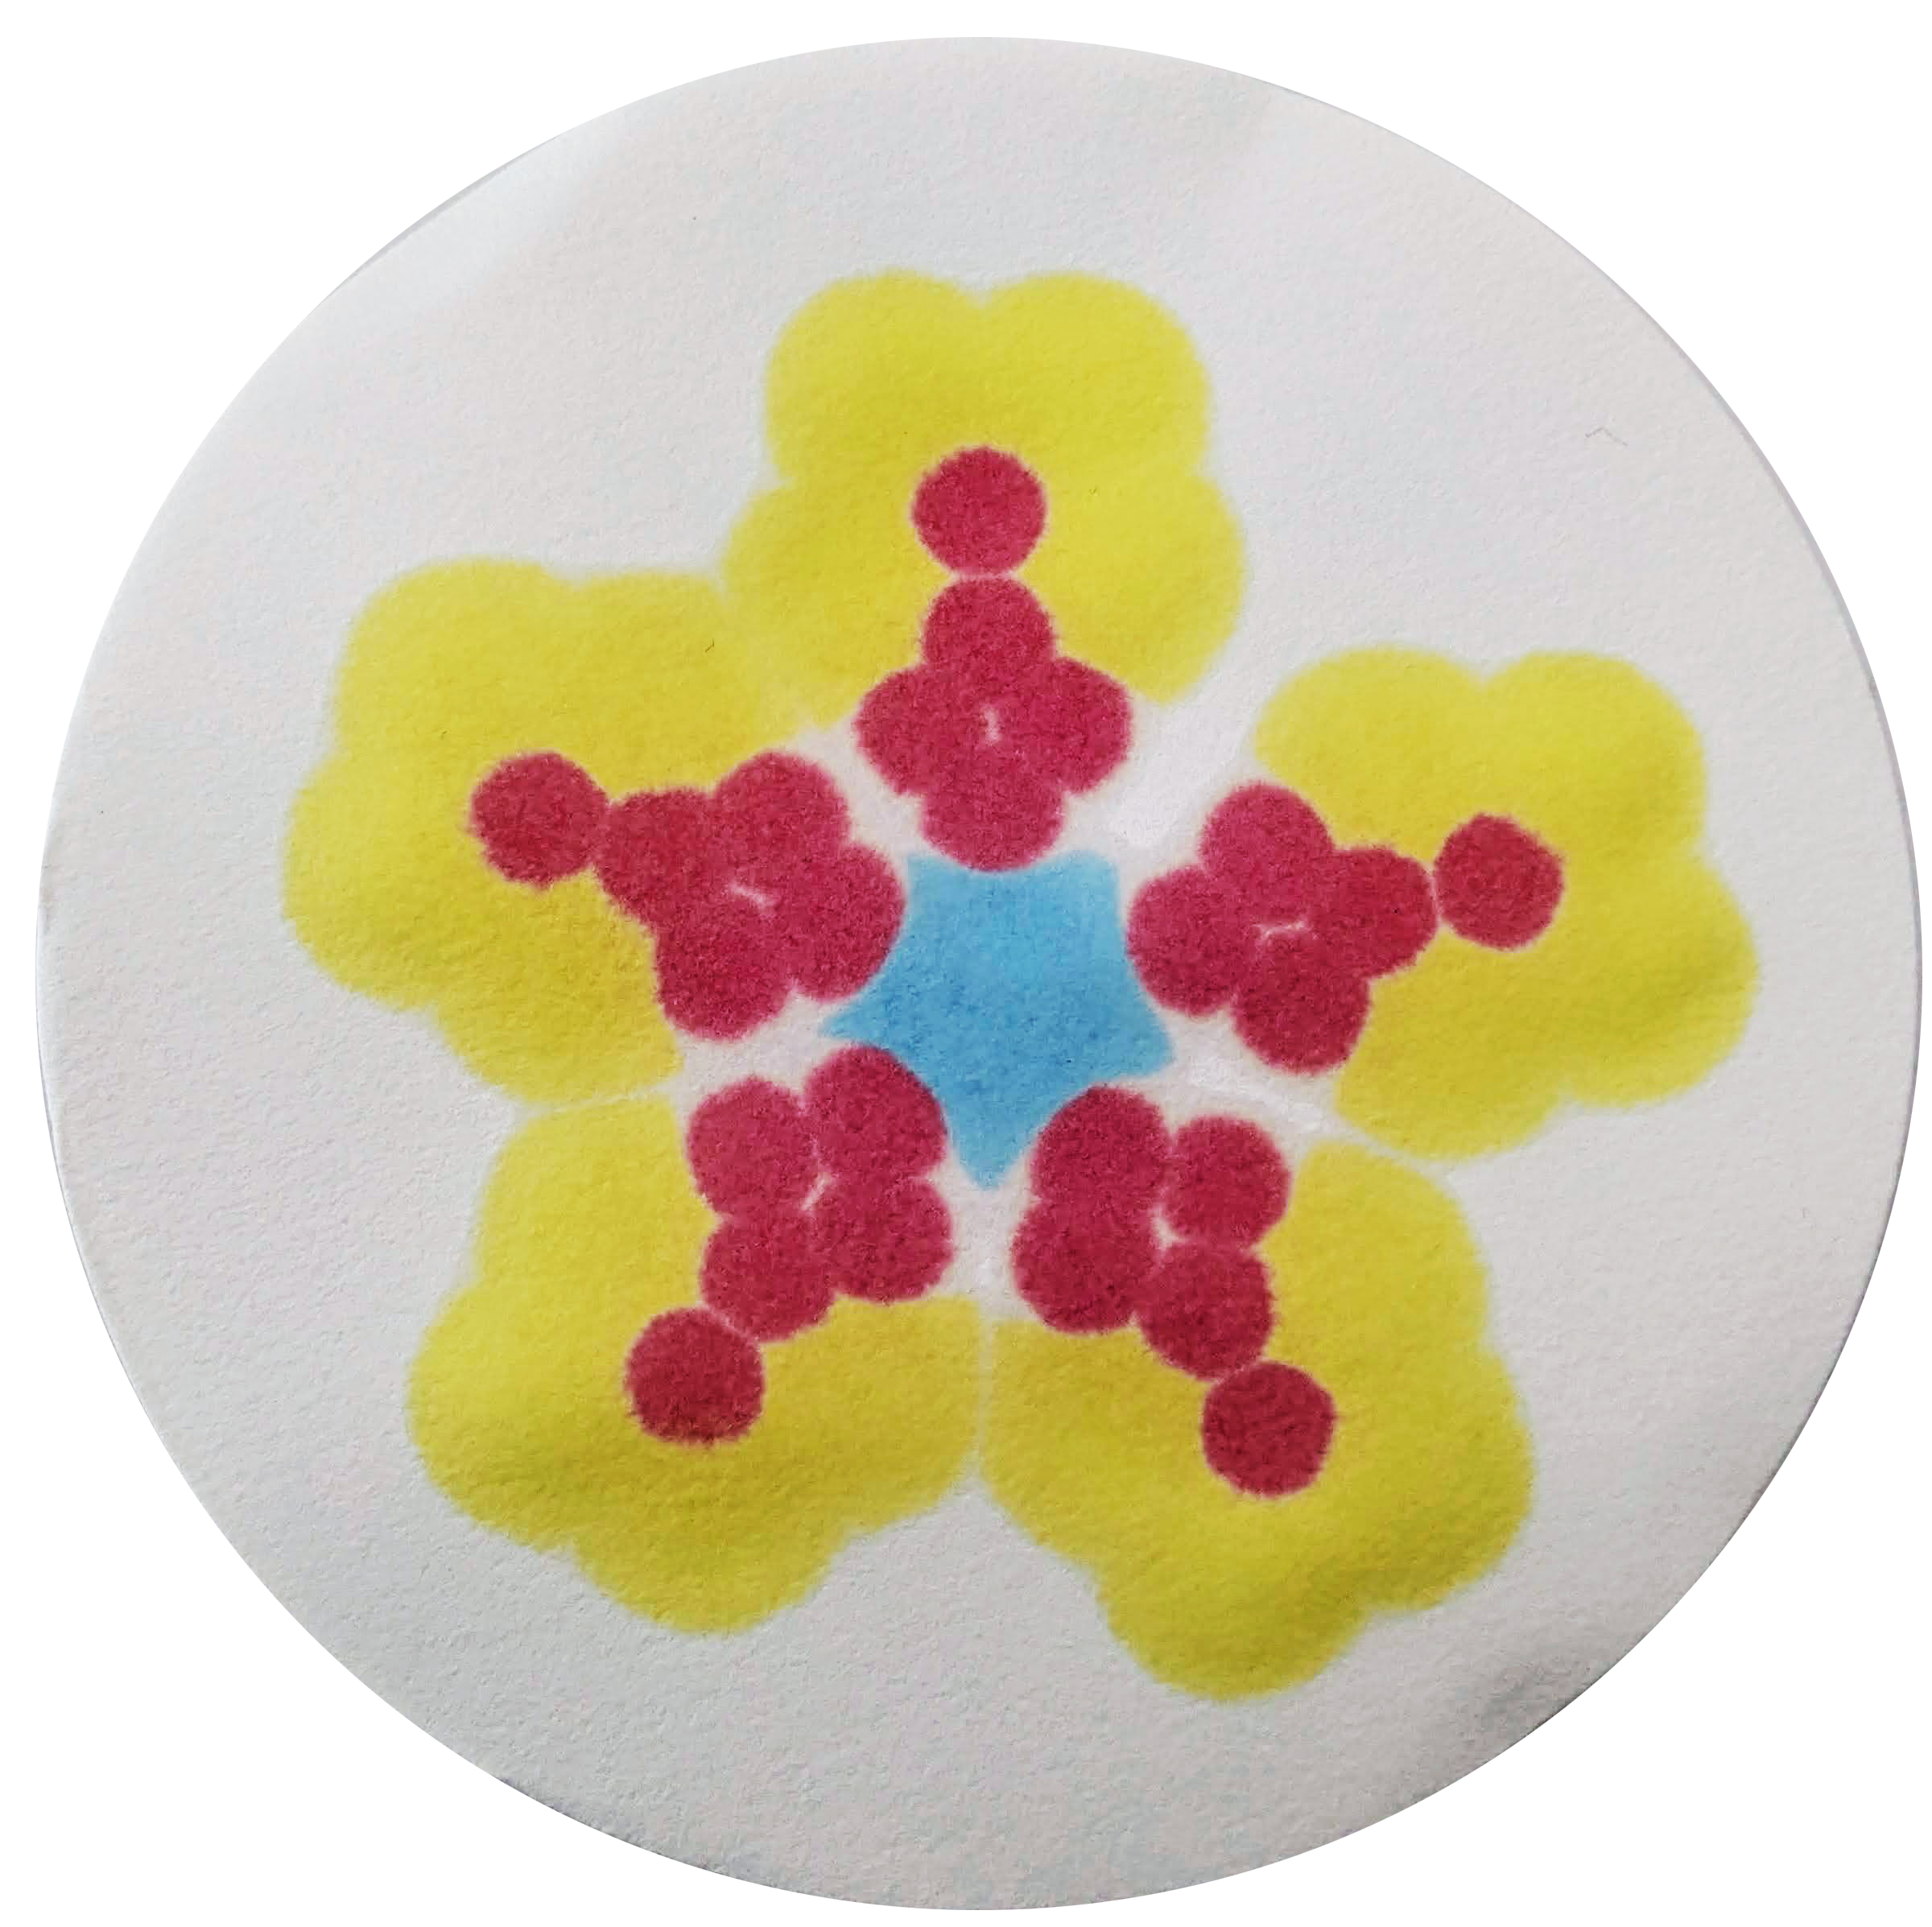
Pipette pointillism
Use the same technique to create a pipetting masterpiece of your own:
choose the colours of food dye to use
set the micropipette and dispense the volume shown in the centre of each circle
place a piece of filter paper over the design to transfer the food dyes and produce a picture
yourgenome.org

Slide 10
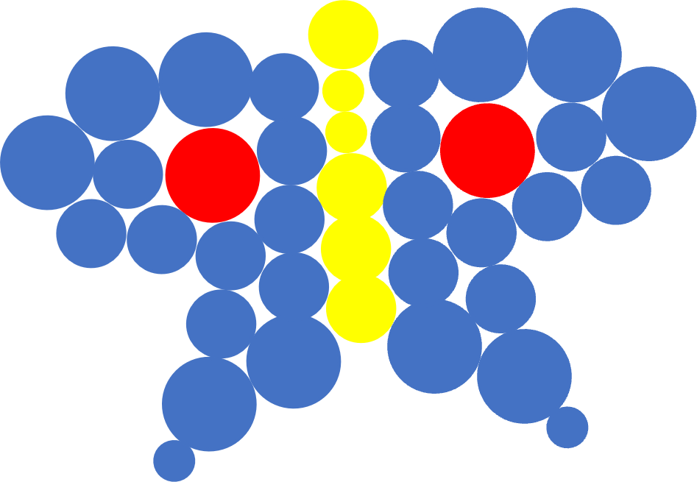
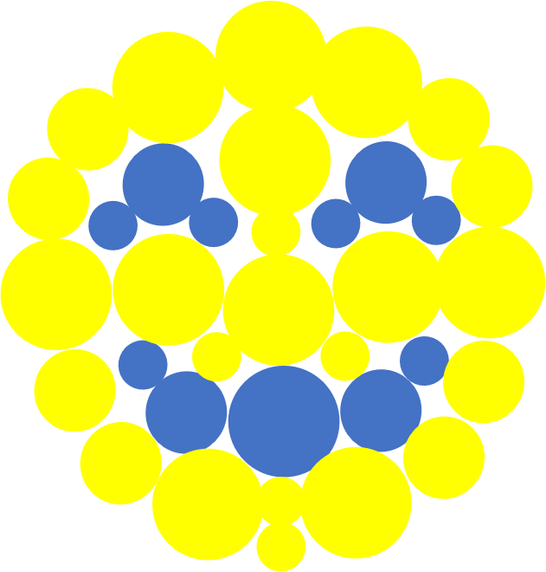
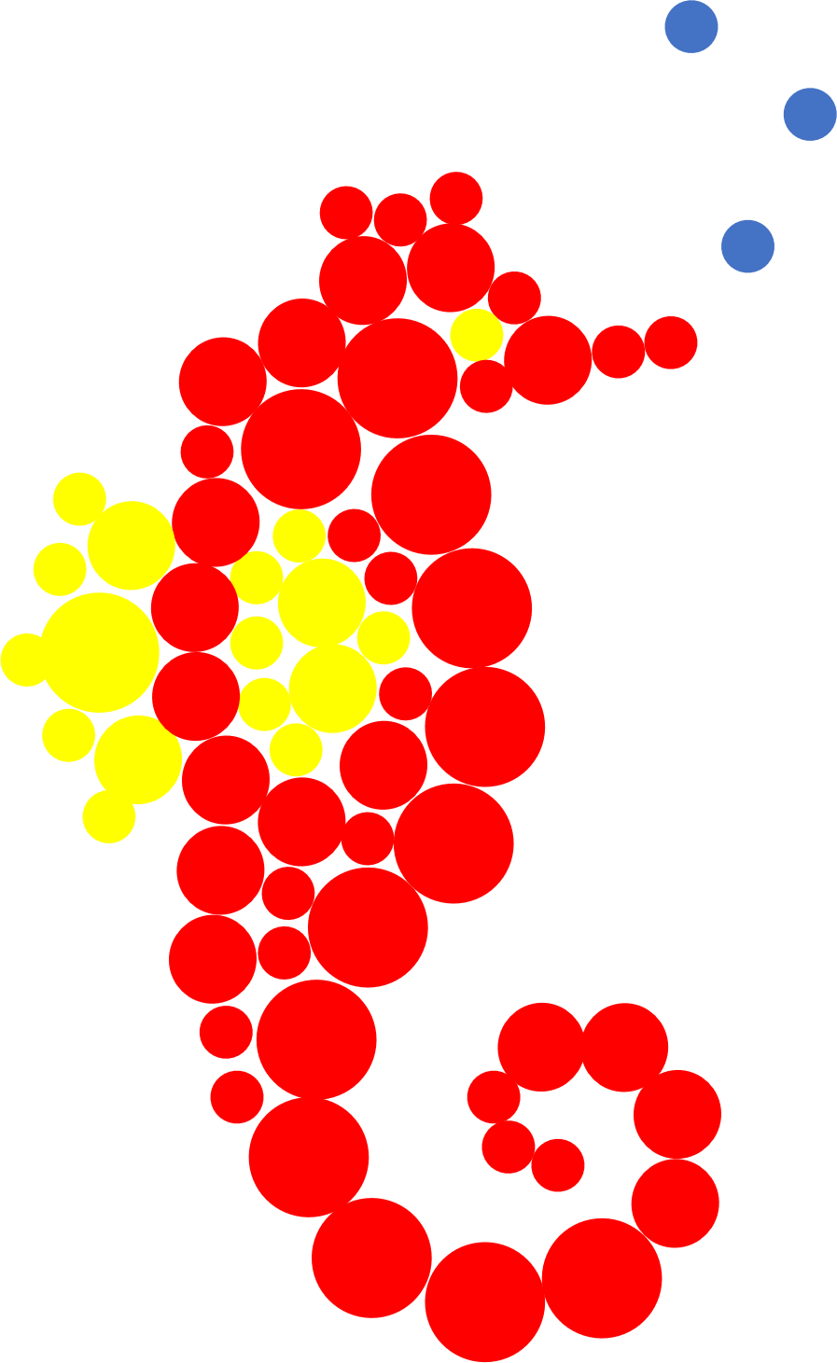
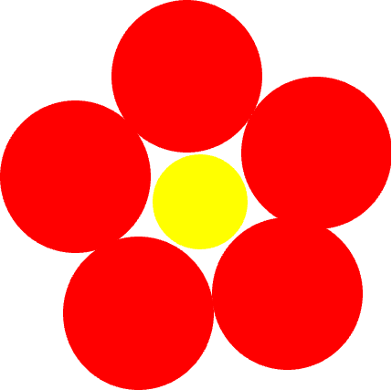
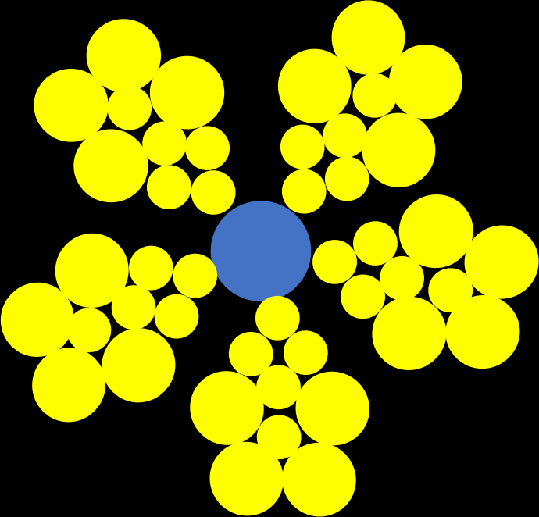
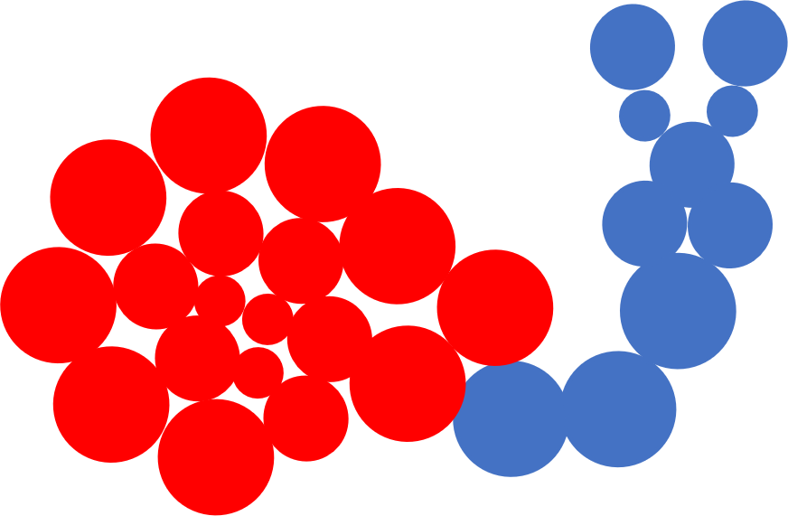
Pipette pointillism
yourgenome.org

Slide 11
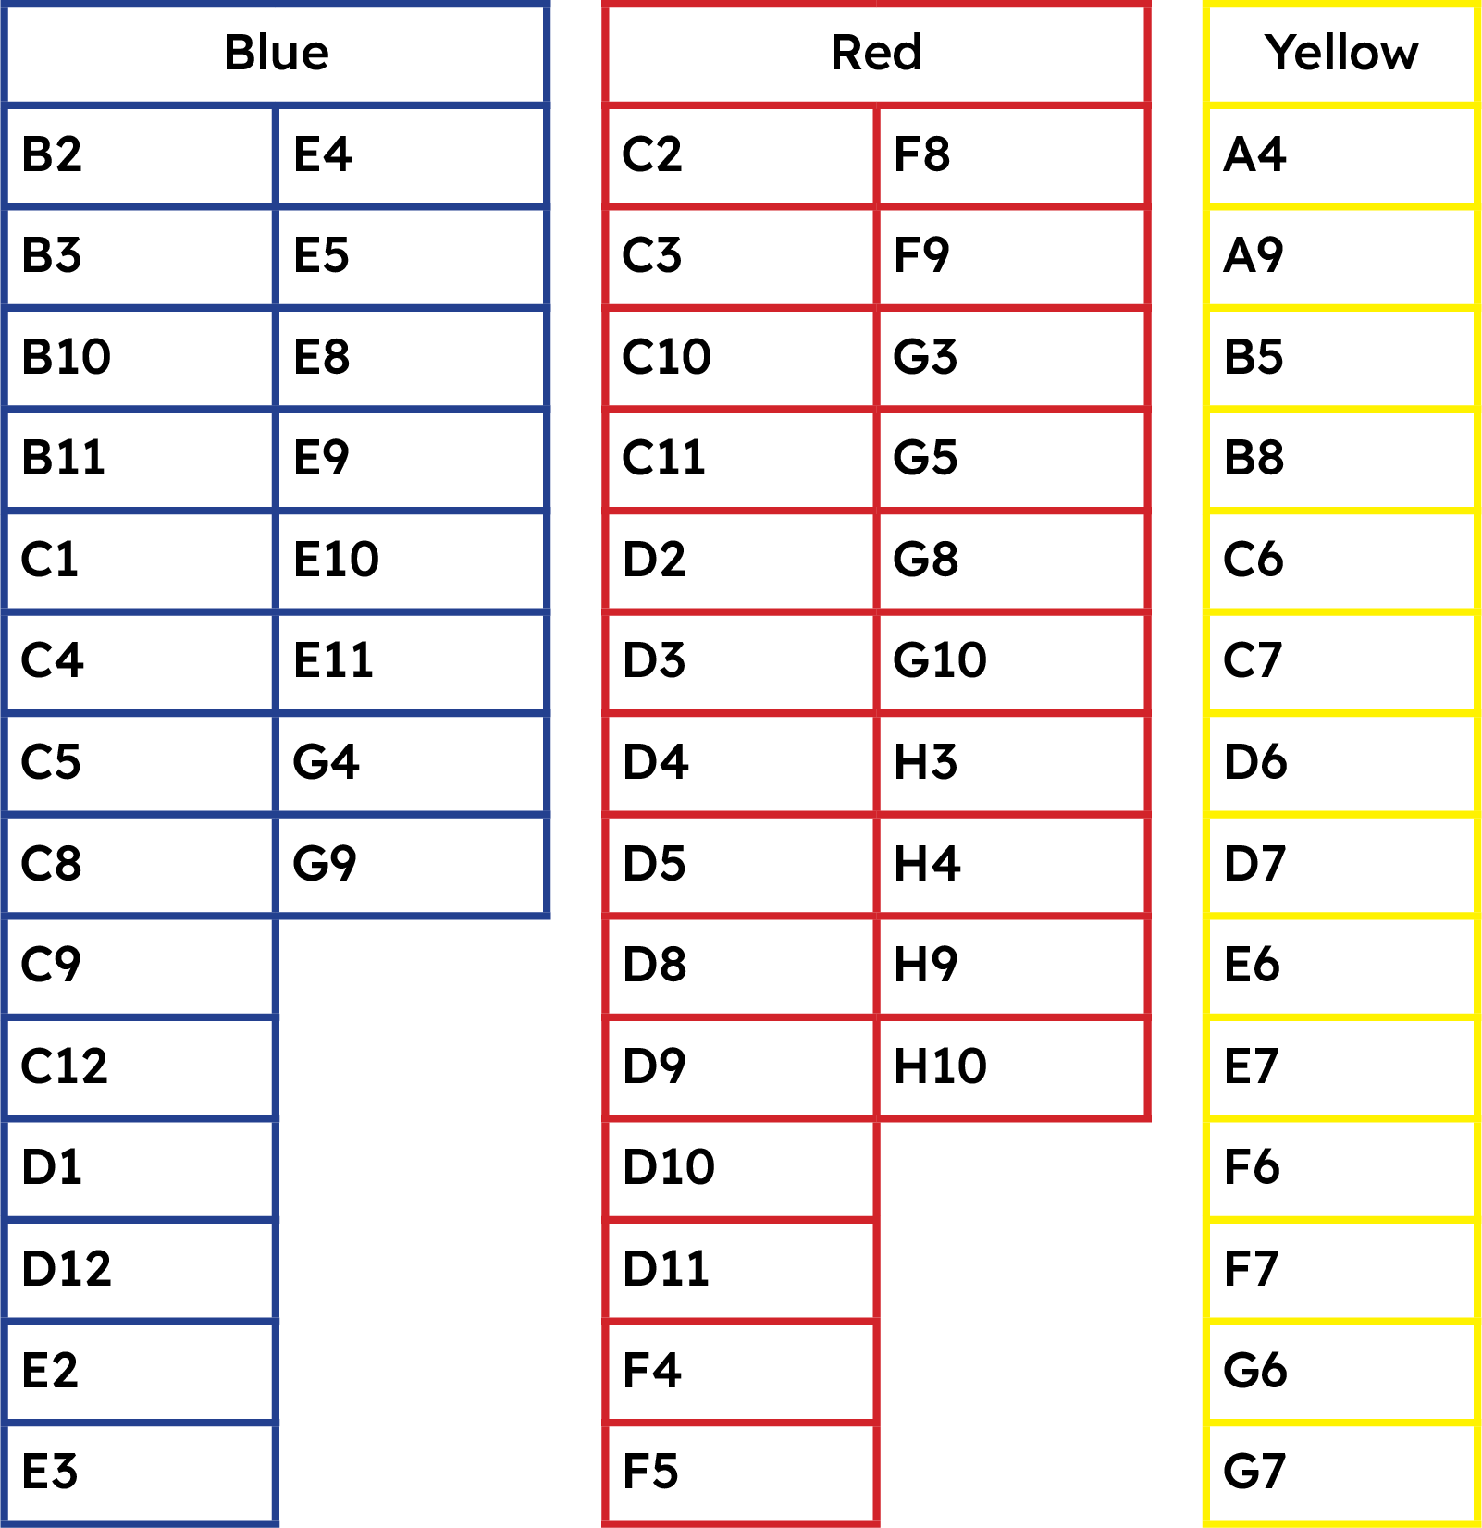
Micropipetting masterpiece
Work in pairs to complete the micropipetting masterpiece using a set of coordinates to pipette food dyes into the correct wells of a 96-well plate
yourgenome.org

Slide 12
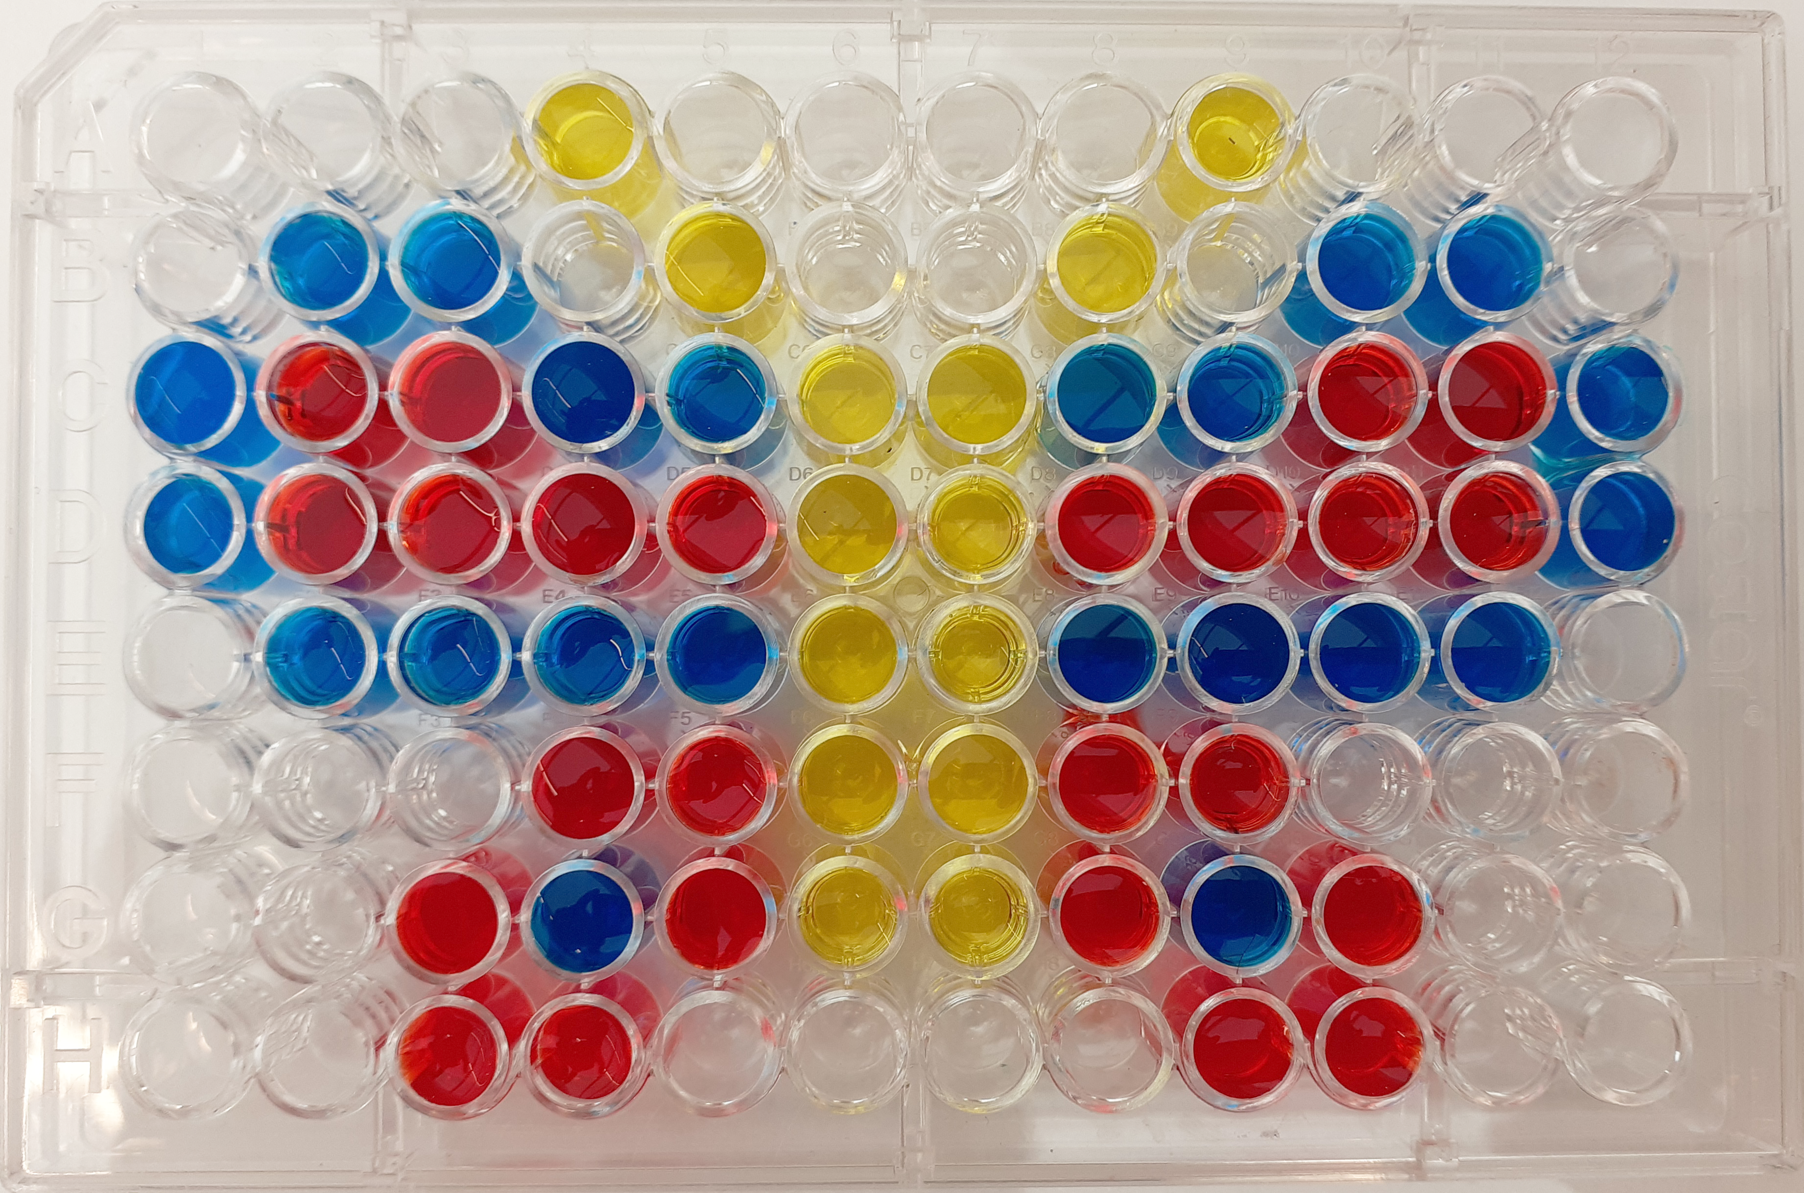
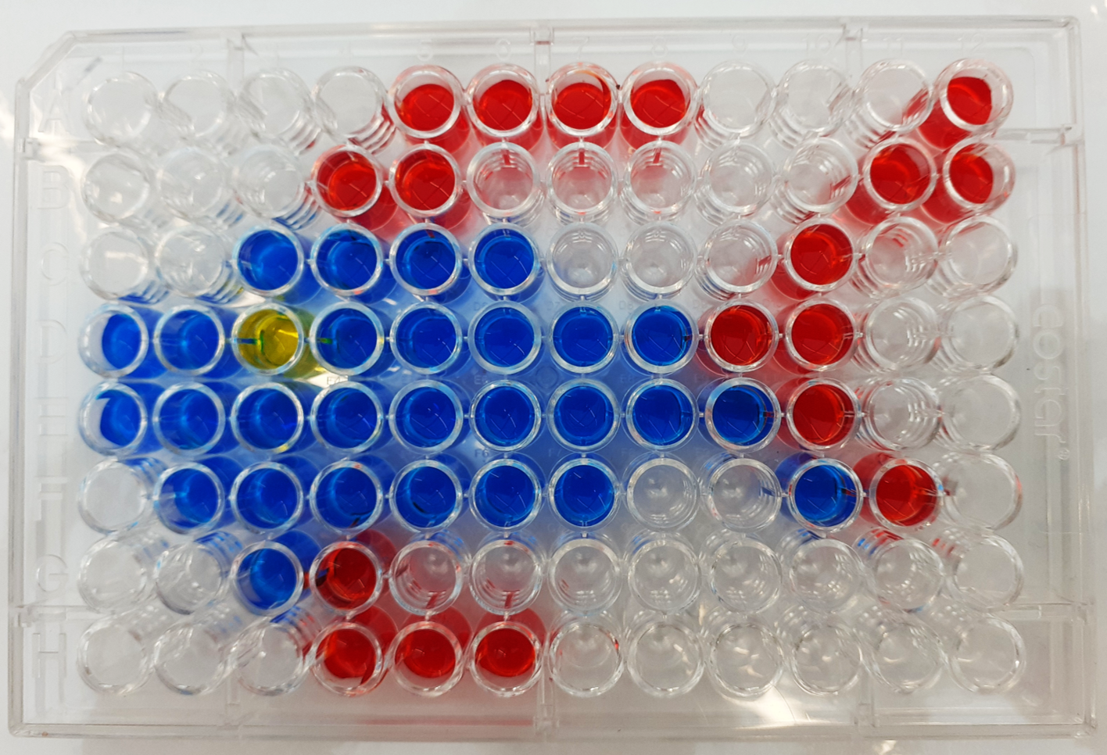
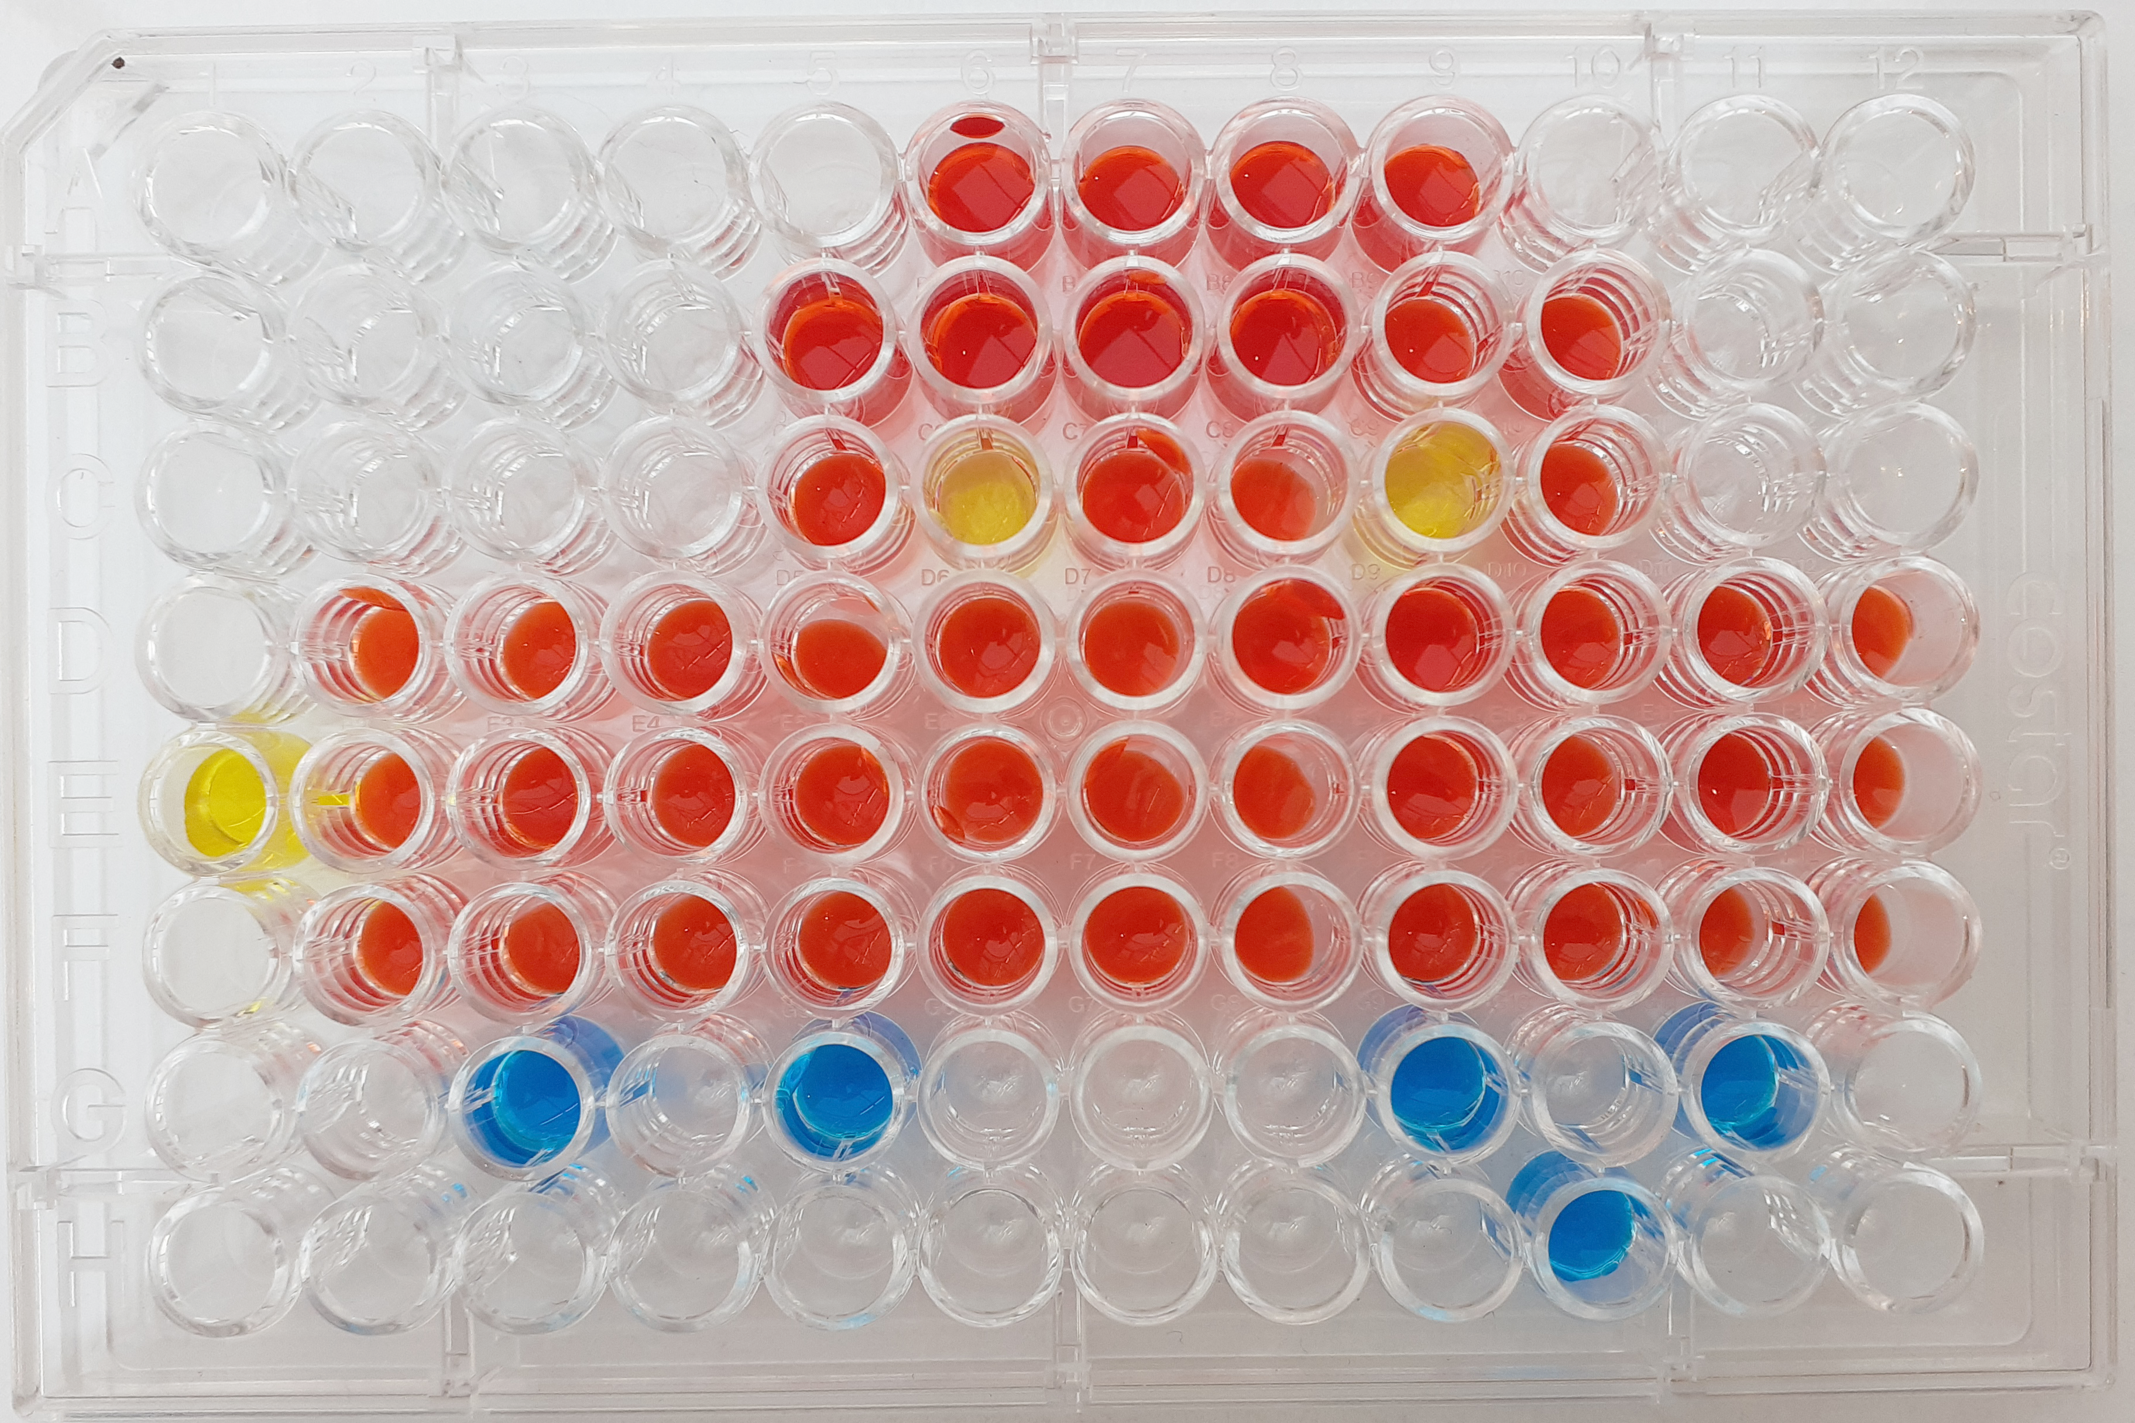
Micropipetting masterpiece
yourgenome.org

Slide 13
Micropipetting
Mastering an essential laboratory skill

